Slide 1
Promoting Innovation, Accessibility, and Security (UITS)
Shawn Skelly, ACIO, Enterprise Applications and Digital Transformation
Kristina England, Senior Digital Experience and Accessibility Specialist
Iris Lyons, Information Security and Disaster Recovery Lead

Slide 2
AI Hub Update
Shawn Skelly

Slide 3
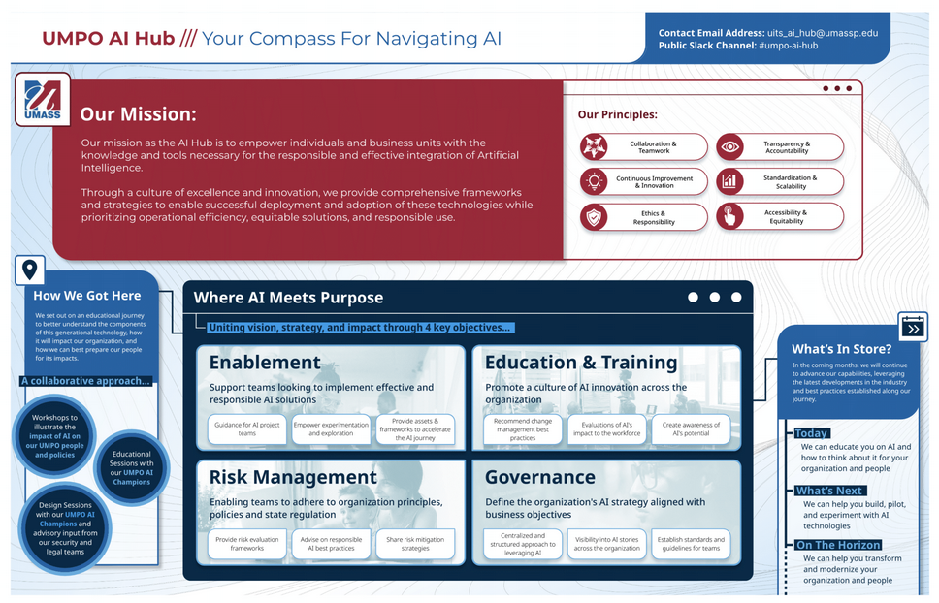
UMPO AI Hub Mission and Principles
Notes:
The image on this slide provides the following information:
UMPO AI Hub: Your Compass for Navigating AI
Contact email address: uits.ai.hub@umassp.edu.
Public Slack Channel: #umpo-ai-hub.
Our Mission: The mission of the AI Hub is to empower individuals and business units with the knowledge and tools necessary for the responsible and effective integration of Artificial Intelligence. Through a culture of excellence and innovation, we provide comprehensive frameworks and strategies to enable successful deployment and adoption of these technologies, while prioritizing operational efficiency, equitable solutions, and responsible use.
Our principles: Collaboration and Teamwork, Continuous Improvement and Innovation, Ethics and Responsibility, Transparency and Accountability, Standardization and Scalability, and Accessibility and Equitability.
How We Got Here: We set out on an educational journey to better understand the components of this generational technology, how it will impact our organization, and how we can best prepare our people for its impacts. We are taking a collaborative approach with workshops to illustrate the impact of AI on our UMPO people and policies, educational sessions with our UMPO AI Champions, and Design sessions with our UMPO AI Champions and advisory input from our security and legal teams.
Where AI Meets Purpose: Uniting vision, strategy, and impact through 4 key objectives:
Enablement: Support teams looking to implement effective and responsible AI solutions, including with guidance for AI project teams, empowering experimentation and exploration, and providing assets and frameworks to accelerate the AI journey.
Education and Training: Promote a culture of AI innovation across the organization by recommending change management best practices, evaluating AI’s impact to the workforce, and creating awareness of AI’s potential.
Risk Management: Enabling teams to adhere to organization principles, policies, and state regulation by providing risk evaluation frameworks, advising on responsible AI best practices, and sharing risk mitigation strategies.
Governance: Define the organization’s AI strategy aligned with business objectives by centralizing and structuring an approach to leveraging AI, providing visibility into AI stories across the organization, and establishing standards and guidelines for teams.
What’s in Store?
In the coming months, we will continue to advance our capabilities, leveraging the latest developments in the industry and best practices established along our journey.
Today: We can educate you on AI and how to think about it for your organization and people.
What’s Next: We can help you build, pilot, and experiment with AI technologies.
On the Horizon: We can help you transform and modernize your organization and people.

Slide 4
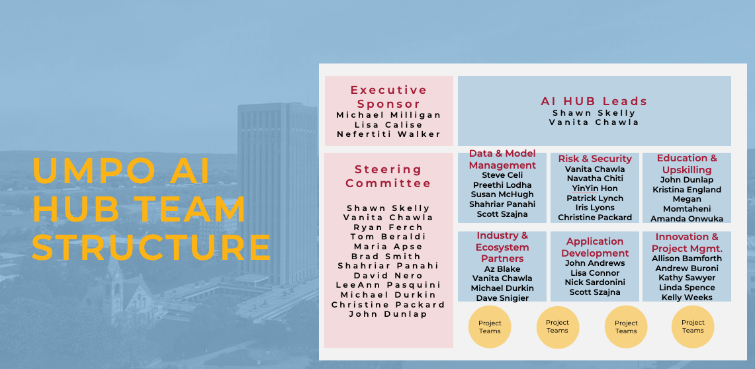
UMPO AI Hub – Team Structure
Notes:
UMPO AI Hub Team:
Executive Sponsors: Michael Milligan, Lisa Calise, and Nefertiti Walker.
Steering Committee: Shawn Skelly, Vanita Chawla, Ryan Ferch, Tom Beraldi, Maria Apse, Brad Smith, Shahriar Panahi, David Nero, LeeAnn Pasquini, Michael Durkin, Christine Packard, and John Dunlap.
AI Hub Leads: Shawn Skelly and Vanita Chawla.
Data and Model Management: Steve Celi, Preethi Lodha, Susan McHugh, Shahriar Panahi, and Scott Szajna.
Risk and Security: Vanita Chawla, Navatha Chiti, Yin Yin Hon, Patrick Lynch, Iris Lyons, and Christine Packard.
Education and Upskilling: John Dunlap, Kristina England, Meghan Momtaheni, and Amanda Onwuka.
Industry and Ecosystem Partners: Az Blake, Vanita Chawla, Michael Durkin, Dave Snigier
Application Development: John Andrews, Lisa Connor, Nick Sardonini, and Scott Szajna.
Innovation and Project Management: Allison Bamforth, Andrew Buroni, Kathy Sawyer, Linda Spence, and Kelly Weeks.

Slide 5
UMPO AI Hub - At a Glance
Use Case Progression
Working groups established and kicked off
AI Hub Website rolled out
AI Use Case Intake Request process defined (Innovation & PM Working group)
Acceptable use Guidelines published (Risk & Security Working group)
Developing an approved tools list
A&F #1 Use case - Expand Buddy Across A&F - Leverage Agentic AI as a customer service agent – Salesforce Agentforce Pilot Project.
A&F #2 Use Case - Expedite Analysis Requests with a SPARC-enabled Chatbot – Discovery in progress
AI Hub Use Case – Enable Zoom AI Companion – Discovery completed
AI Hub Use Case - eForms Assistant BETA program – Discovery in progress
GenAI Playground – Partnership with UMass Amherst, environment under construction

Slide 6
Thank you
Questions?
AI Use Case request - Contact Shawn Skelly / Vanita Chawla
AI Hub Website
Slack channel: #umpo-ai-hub
Notes:
Questions?
AI Use Case request - Contact Shawn Skelly / Vanita Chawla
AI Hub Website
Slack channel: #umpo-ai-hub

Slide 7
Digital Accessibility Compliance Project Update
Ensuring disability inclusion at the UMass President’s Office
Kristina England

Slide 8
All digital accessibility document training converted to self-paced training in LinkedIn Learning
Current catalog of self-paced training:
Create Accessible Emails
Create Accessible Word Documents
Develop Accessible Presentations
Create Accessible Excel Spreadsheets
Create Accessible Social Media Posts
Intro to Video Accessibility
Create Accessible Slack Posts
Departments currently completing training:
Academic Affairs, Student Affairs, and Equity
Board of Trustees Secretaries
Communications
General Counsel (Individually assigned based on availability)
Internal Audit
UITS

Slide 9
Content Redesign Effort Examples
Board of Trustees created an accessible meeting agenda template and is converting all Board of Trustees Policies PDFs into accessible HTML content.
Internal Audit developed Fraud Awareness PowerPoint training content with accessibility best practices in mind.
UPST fixed accessibility issues with Bank Card training.
Travel and Expenses is converting all PDF job aids to knowledge articles.
Worked with Employee Services to convert the Pay Calendar PDF into an accessible and mobile responsive html solution.
Working with Academic Affairs, Student Affairs, and Equity to redesign the Student Profile Report (added chart descriptions and headings, and fixed inaccessible tables).

Slide 10
Third-Party Product Testing
UITS developed the Accessibility Tracker, which shows the current state of all products owned by the President’s Office.
UITS documented the Third-Party Testing process in the publications website so that it can be referenced by everyone at the President’s Office.
UITS kicked off testing of critical products owned by UITS that have not been tested before.
Admin and Finance prioritizing A&F products that need to be tested.

Slide 11
Video Accessibility
All Massachusetts.edu marketing videos have been updated to include captions and transcripts if these accessibility requirements were missing.
Ron Agrella and Tracy Axelson to work with the Communications Office on adding audio descriptions to public-facing marketing videos.
What are audio descriptions?
Audio descriptions provide the blind community with spoken descriptions of key visual elements in a video or multimedia content. Anyone with a traumatic head injury may be asked by their doctor to utilize audio descriptions as well.
Once all Communications Office videos are completed, additional videos will be reviewed to confirm they have captions and a transcript, and whether audio descriptions are needed.

Slide 12
Audio-Described Video Example
Indiana University’s “Think Before You Click” Information Security Video.
For anyone that has access to Netflix and Disney streaming services, there are quite a few shows and movies that have audio descriptions built in.
There are not many higher ed examples currently, though now that audio descriptions are required as part of the new law per Web Content Accessibility Guidelines A and AA, several universities are working on initiatives to incorporate them into existing videos.

Slide 13
Additional digital accessibility project updates
Digital Accessibility Liaisons from each department have been meeting and completing training since September 2024.
Several liaisons have found ways to improve their team’s content and have provided presentations to their teams.
After completing training, liaison Kate Carroll in UITS decided to make digital accessibility the focus of her project for a UMass Dartmouth Project Management Course. The final deliverable was an accessible PowerPoint template and accessibility how-to resources for UMass Dartmouth Students in the Charlton School of Business.
Procurement is working on an accessible procurement workstream that will help ensure we streamline the process for purchasing accessible products going forward.

Slide 14
Important Advice: Progress Over Perfection
Meryl Evans, a Deaf disability advocate and accessibility specialist, has championed the idea of “Progress Over Perfection.”
As a metaphor, she compared accessibility to when she trained for a half marathon. Each day, she challenged herself more and more, and each day she accomplished more.
Every step matters and the biggest step is not getting stuck at the starting line.
The departments here have been doing just that – it’s been incredible to watch folks learn and start to introduce accessibility into their day-to-day jobs.

Slide 15
March Phishing Campaign Summary
Iris Lyons

Slide 16
By the Numbers
Two sophisticated phish messages sent from impersonated internal users indicating urgency and required action to all 492 UMPO employees in March
249 messages were opened by users
…of the 249, 163 links were clicked
…of the 163, 56 usernames and passwords were entered
Had this been real, these credentials would have been obtained by a malicious actor.

Slide 17
Reminders
Slow down and Know the Source - Emails from outside the UMSO organization contain an orange banner to remind you to check for legitimacy
Check the email address
Look for strange domain names, mismatched fonts, miss-pellings, unusual requests, etc.
VERIFY then TRUST – Reach out to the requester; if the request is real, they will confirm

Slide 18
Example 1 of 3

Slide 19
Example 2 of 3

Slide 20
Example 3 of 3

Slide 21
What’s Next
Our Path Forward
Continued promotion of the “Report Phish” within Outlook
Analyzes message legitimacy back to user
This campaign had 160+ reports, an increase over the previous campaign!
Increase digital and physical signage promoting the function
Personalized zoom training for users who would have been compromised.
Additional phishing campaigns to come.

Slide 22
Thank you!
These campaigns make us more secure – we will continue to make folks aware of all security risks – we appreciate your support for training and encouraging staff!!!
Our team is here to help – no judgement!
Nick Bonczyk
Danny Galvin
Iris Lyons
Brad Smith

