Slide 1
PDF to HTML Conversion
by Tracy Axelson, UMass Office of the President
Digital Experience Team, University Information Technology Services

Slide 2
2024 Extension to ADA Title II
The rule states that all digital content must be fully accessible.
“Web content” is defined as the information and experiences available on the web, like text, images, sound, videos, and documents.
Web Content Accessibility Guidelines (WCAG) Version 2.1, Level AA is the technical standard for state and local governments’ web content and mobile apps.
Effective: June 2024
Compliance Deadline: April 26, 2026
Compliance Extension: April 26, 2027

Slide 3
WCAG 2.1 AA
The World Wide Web Consortium (w3.org) maintains the technical standard that governs digital content and web experiences
The four main areas of the standard are:
  Perceivable: Users must be able to see or hear the content.
  Operable: Users must be able to use controls, buttons, and menus, whether by mouse, touch, or keyboard.
  Understandable: Text and site navigation must be clear, readable, and predictable.
  Robust: Content must work well with current and future tools, like screen readers.

Slide 4
2024-2026
Digital Experience Team Web Accessibility Project

Slide 5
Web Document Inventory
We started tracking all documents either hosted-on or linked-to from our websites. Here’s what we found:
  Over 1100 documents
    Of these we archived 287
    169 were old and could be deleted
    35 were linked out to 3rd party sites, such as the IRS website
    609 were left and most of these were PDF files

Slide 6
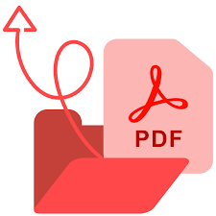
Why so many PDFs?
PDF started in the 90’s and was quickly adopted because it allowed:
  Cross-platform sharing
  Application agnostic sharing
  Locked layouts for viewing and printing
  Document security

Slide 7
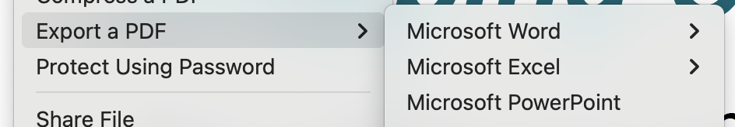
Is PDF Really Necessary?
Platform and application differences are not as big a concern as they used to be.
Locked layouts are not desireable for accessibility.
PDFs can be manipulated/converted very easily

Slide 8
OK, so let’s make ‘em accessible!
You’ve got the source file, right?

Slide 9
Make a PDF accessible
Two options:
  Make the source file accessible and then remake the PDF.
  Edit the PDF code to make sure that it is tagged properly, the reading order is correct, all images have alternative text, tables are scoped correctly, etc.

Slide 10
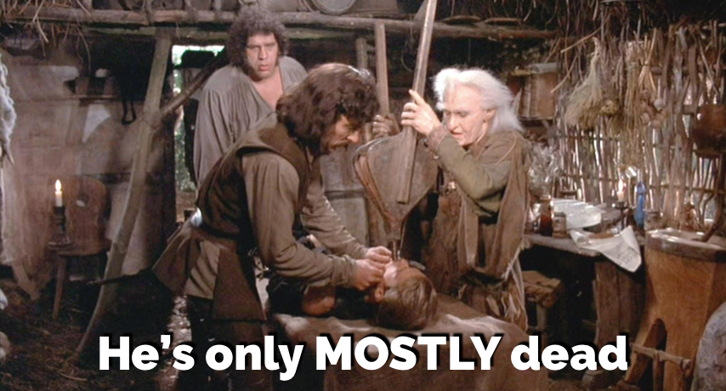
Even if you do everything right, a PDF is only MOSTLY accessible
PDFs can not be fully accessible because:
  Not mobile-responsive
  Cannot reflow text beyond 150%
  Do not support high contrast mode
  Do not allow the changing of fonts by the user
  Do not allow the changing of font size by the user

Slide 11
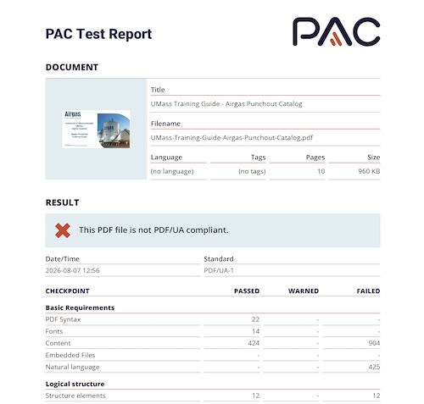
How do I know if my PDF is accessible?
Adobe Accessibility Checker + manual testing with keyboard and screen reader.
Free PDF Accessibility Checker (PAC) for Windows
  Recommended by the disability community
  More reliable than the Adobe Accessibility Checker
  Provides guidance on how to perform manual checks

Slide 12
What if my PDF is not accessible?
Keep the document in Word, Excel or PowerPoint instead of PDF
  Create the document accessibly using best practice and run the application’s accessibility checker.
Recreate your document as HTML:
  Fully accessible
  Permanent link structure/Redirects
  Navigational structure
  Easy to maintain/edit content
  Security for editing
  Security for viewing
  Printable

Slide 13
Samples & Demo

Slide 14
Resources
ADA Title II New Rule Fact Sheet
World Wide Web Consortium: WCAG 2.1
Techniques for Accessible PDFs to meet WCAG 2.1 (from W3.org)
Adobe Acrobat Accessibility Checker
PDF Accessibility Checker (Windows only)
Creating Accessible PDFs (LinkedIn Learning Course) (8 hrs, 16 mins)

