Slide 1
Queer Theory & History of Pride
October DEIA Event
Notes:
Disclaimer: many of you may consider the term ‘queer’ to be a slur or used in a pejorative sense. It still can be used negatively. However, it has since been reappropriated as a positive self-designation by gay or queer militants in the early 1990s. Today, it has been reclaimed by the community and can be used as a self-affirming umbrella term. As always, context is everything.

Slide 2
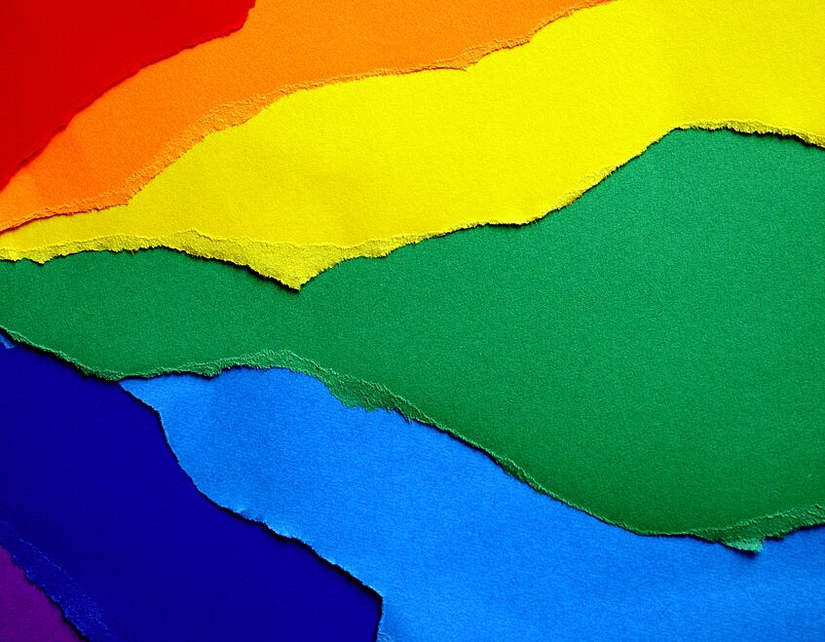
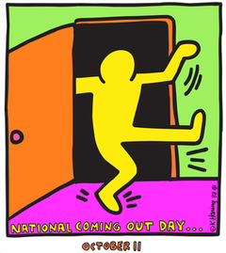
October – LGBT History Month
In 1994, Rodney Wilson, a Missouri high school teacher, believed a month should be dedicated to the celebration and teaching of gay and lesbian history
National Coming Out Day occurs on October 11th
International Pronouns Day occurs today on October 16th
Organizations including GLAAD, the Human Rights Campaign, the National Gay and Lesbian Task Force, the National Education Association and other national organizations endorse LGBT History Month
Notes:
You may be wondering why this DEIA event is being held in October instead of June during Pride Month. That’s because October is LGBT History Month, and we all know how busy June gets. LGBT History Month was started by Missouri high school teacher, Rodney Wilson, to support his LGBTQ+ students. October also includes National Coming Out Day on October 11th and International Pronouns Day, which is today to support respecting, sharing, and educating about personal pronouns. ‘Coming Out’ refers to the act of openly disclosing one’s gender identity, sexual orientation, or other personal identities previously kept a secret. Every queer person has their story of how they have grown into their identity; the first person they came out to, when or if they told their parents or their grandparents and how that went, if they had been outed to people before they were ready, how their own perception of their queerness has shifted over time, it is uniquely personal to every member of the community. Some stories are that they’ve lived their whole lives and never felt safe or comfortable enough to come out.

Slide 3
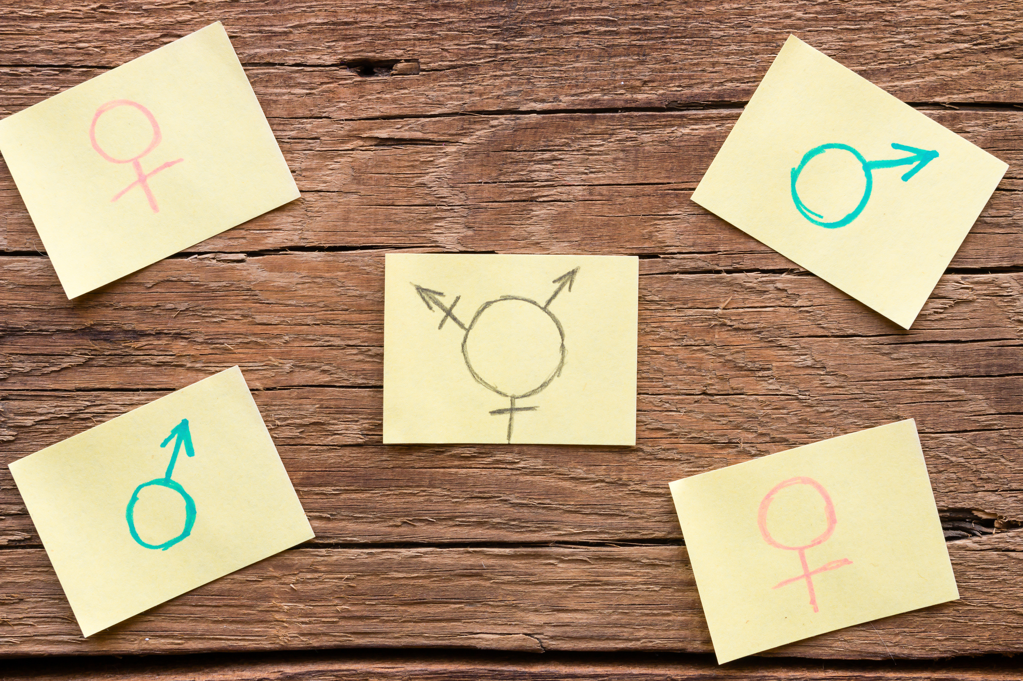
What is Queer Theory?
Queer theory is a field of study that examines the nature of sexuality and gender-based normativity and how society defines and polices the concepts of heterosexuality and gender and sexual identities
Queer theory aims to deconstruct the status quo of what is “normal” or acceptable
  Heteronormativity
“Masculine and feminine roles are not biologically fixed but socially constructed.” – Judith Butler
Notes:
Queer theory is a field of study that emerged in the early 1990s which examines the nature of sexuality and gender-based normativity and how society defines and polices the concepts of heterosexuality and gender and sexual identities. Queer theory aims to deconstruct the status quo of what is “normal” or acceptable. Heteronormativity is the belief that heterosexuality is the default, therefore the preferred, expression of sexuality. Queer theory, at its core, has always been tied to oppression. It is important to be educated on queer history to fully understand the way queer theory challenges traditional approaches and works against social inequality. So for this presentation, I will be walking you through the context of LGBTQ+ history and we will revisit this concept at the end.

Slide 4

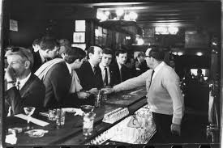
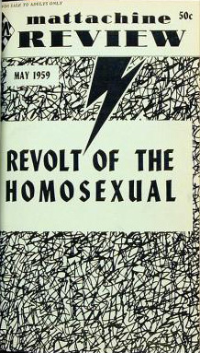
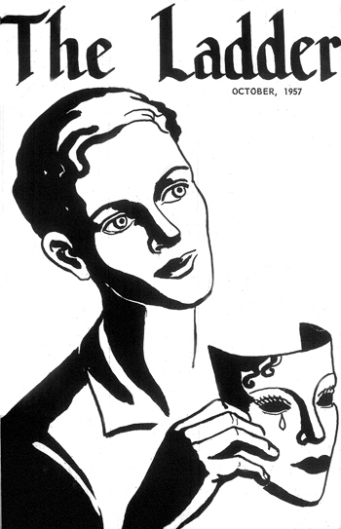
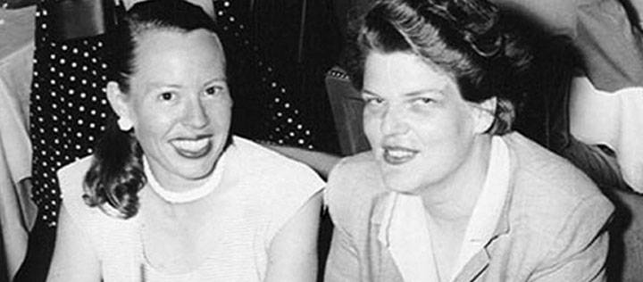
Before Stonewall (1620-1969)
Colonial Plymouth est. 1620 and with that, the establishment of gender norms in America
LGBTQ+ in World War II
The U.S. Homophile Movement refers to the local, national, and international social-political movement for gay and lesbian rights which emerged following World War II
  The Mattachine Society and the Daughters of Bilitis
Daughters of Bilitis publication, The Ladder, and the Mattachine Society publication, Mattachine Review
Daughters of Bilitis Founders
Phyllis Lyon (left) and Del Martin (right)
Mattachine Society 1966 “sip-in”
Notes:
To keep this presentation within the hour, I am going to start with Colonial life and the founding of our Nation. Although, I implore you to do your own research on how queerness presented itself in ancient civilizations. Additionally, we often think about American history through a post-colonial lens, but indigenous cultures have long been recognizing diverse sexual orientations and gender identities on this land. In our great home state of Massachusetts, colonial Plymouth was established in 1620 with Puritan norms. This established gender norms in America and determined the nuclear family unit was the basis for all other institutions such as government or church. Sodomy laws were put in place and remained until challenged in 1925. Punishments for participating in same-sex acts could include whippings, jail, and the death penalty.
Over this period, we had women dressing as men to fight for the Union in the civil war, World War II, and the birth of the Homophile movement. During WWII, nearly 100,000 German homosexuals were rounded up in concentration camps and marked with a pink triangle (another reclaimed symbol of the community that is rooted in hatred/oppression). Notably, they were the last demographic to be released from the camps at the end of the war as homosexuality remained to be illegal in Nazi Germany’s successor states.
The Homophile movement refers to the social-political movement for gay and lesbian rights which emerged following WWII. At the time, it was still entirely illegal in the US to engage in same-sex acts, there was a moral panic known as the Lavender Scare where gay men and lesbian women were said to be national security risks and communist sympathizers, which led to the call to remove them from state employment. On top of job discrimination where people could be fired for being openly gay, the community was also facing violence from the police and general public. Many consider the birth of the homophile movement to be sometime around 1950/1951, a date that corresponds with the founding of two prominent gay and lesbian rights groups, the Mattachine Society and the Daughters of Bilitis. There were some additional gay rights organizations in the US that pre-date the Mattachine Society, including the Chicago Society for Human Rights. The Chicago Society for Human Rights ceased to exist when most of the members were arrested. Although, the Mattachine Society became one of several prominent groups organizing during the period of LGBTQ+ activism. Another prominent activist group mentioned previously was the Daughters of Bilitis; founded by mostly working women of color, as a private lesbian social club to avoid the frequently raided bar scene. The Daughters of Bilitis became the first lesbian rights group and published the first national distributed lesbian magazine in the United States. In 1966, just three years before Stonewall, members of the Mattachine Society organized a “sip-in” where they openly declared their sexuality at bars, daring staff to turn them away and suing establishments who did. The Commission of Human Rights ruled that gay individuals had the right to be served in bars, and police raids were temporarily reduced.

Slide 5
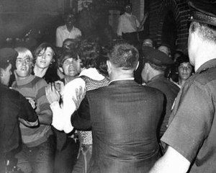
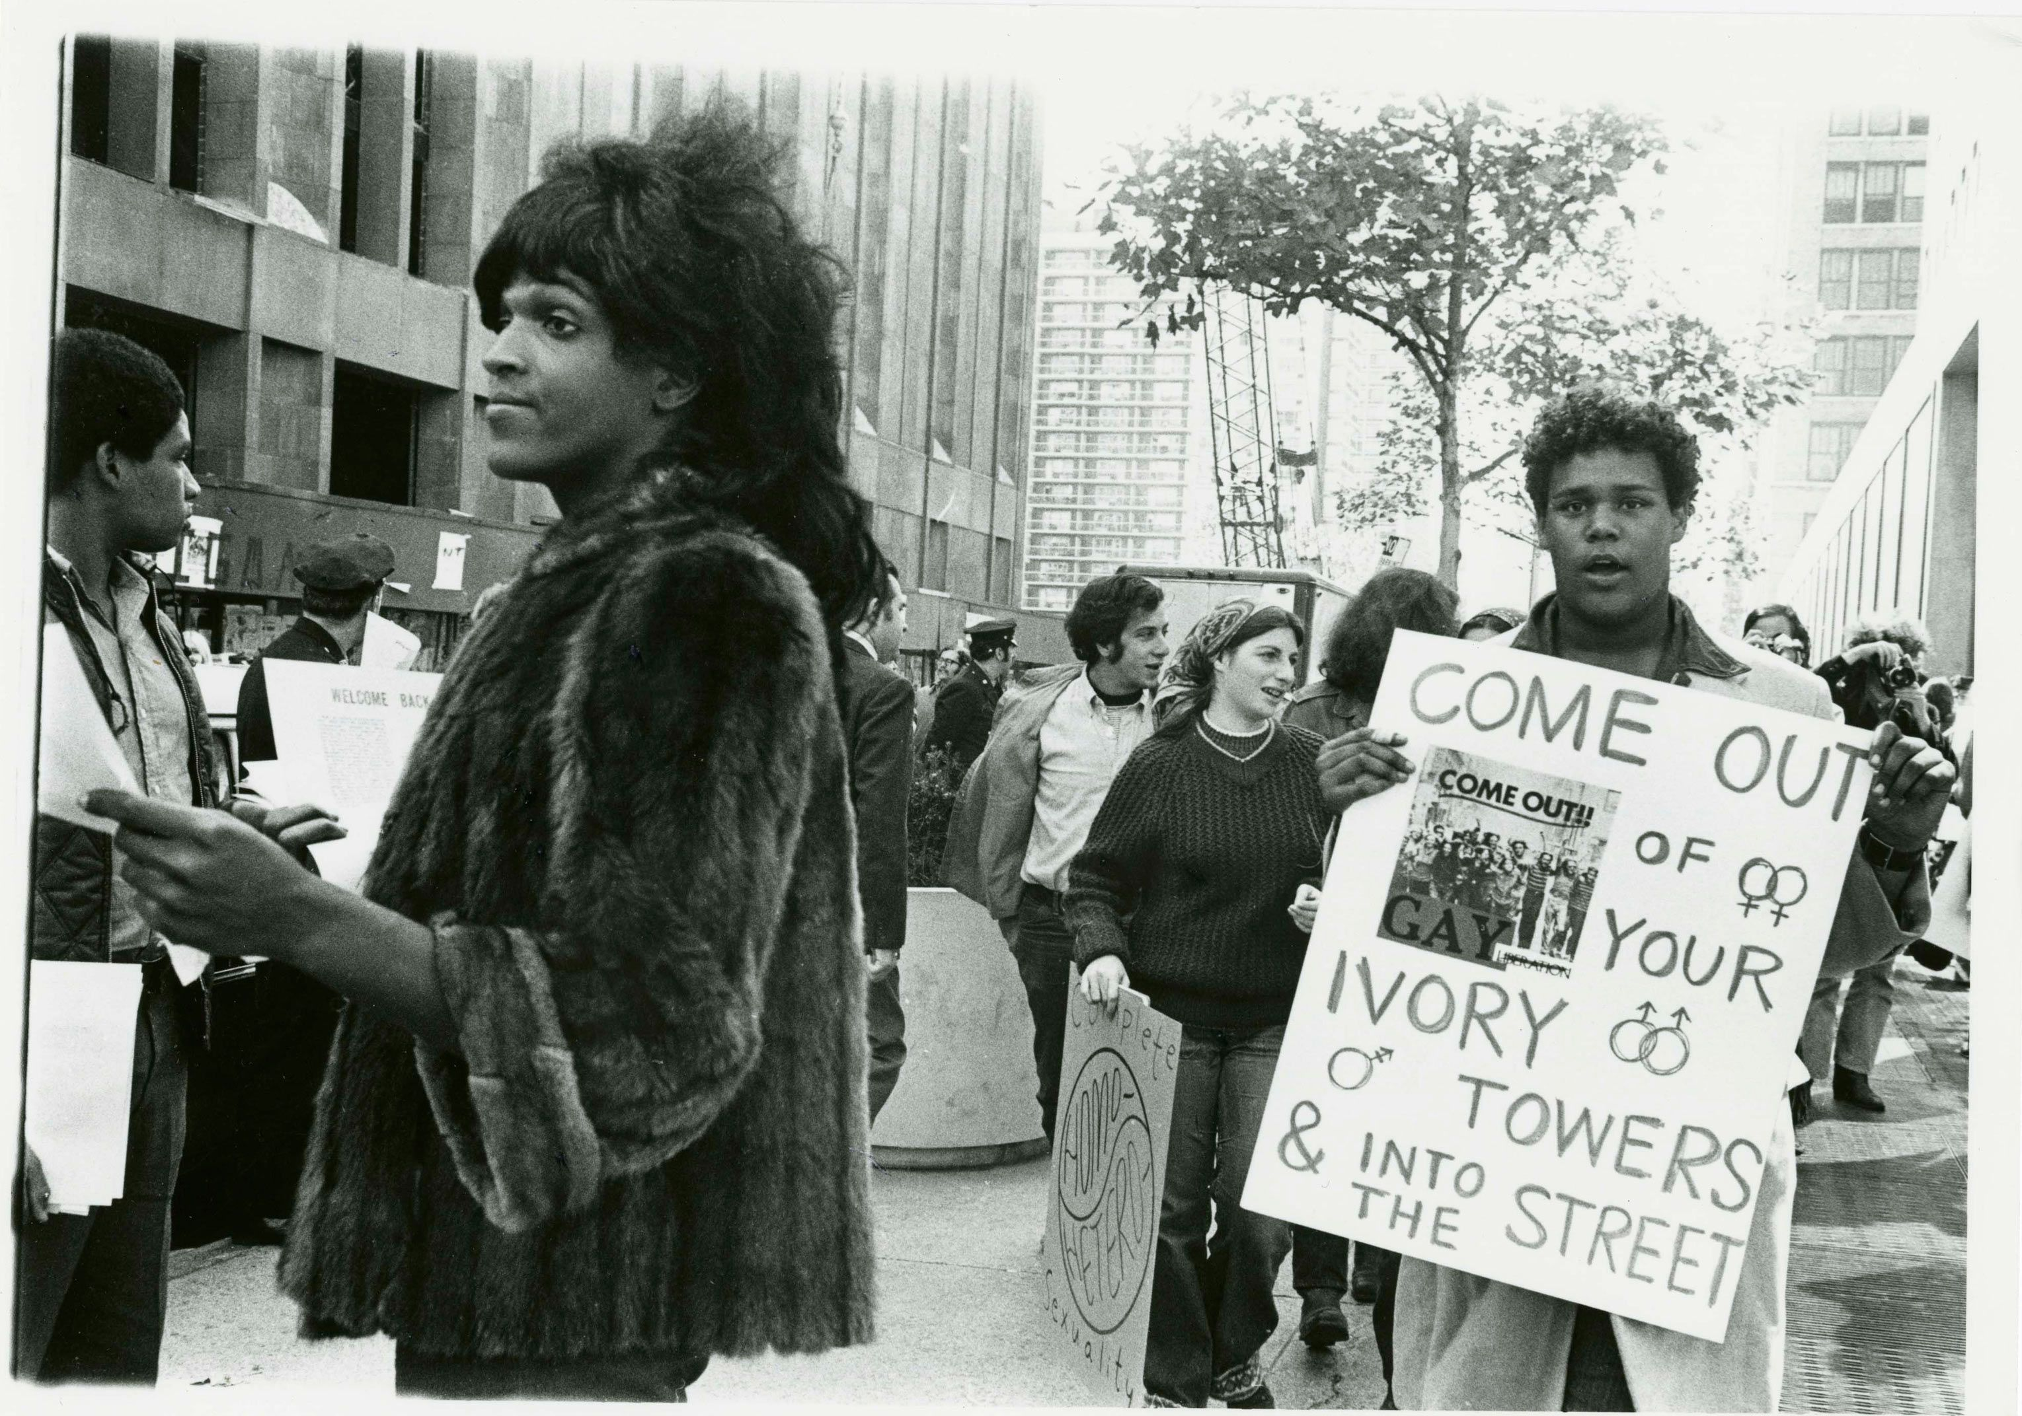
Stonewall Uprising (June 28th, 1969)
“History isn’t something you look back at and say it was inevitable, it happens because people make decisions that are sometimes very impulsive and of the moment, but those moments are cumulative realities” – Marsha P. Johnson
One of the only recorded images of the first night of Stonewall
Notes:
In the 1950s and 60s, very few establishments openly welcomed gay people. The rare exceptions were often bars, although the owners and managers were rarely gay. The Stonewall Inn in New York City was run by the Mafia and catered to some of the poorest and most marginalized people in the gay community, from drag queens to homeless youth to the newly self-aware transgender community. The mafia connection might be surprising, but as long as they continued to turn a profit, they cared very little what happened to their clientele. Claims have been made that the mafia would even blackmail high-profile patrons who wanted to keep their sexuality a secret. In the early morning hours of June 28th, 1969, the Stonewall Inn was once again raided by New York police. The NYPD shut down the party, but the patrons refused to disperse from the sidewalk outside the bar. This sparked a series of spontaneous, violent demonstrations fighting back against government-sponsored persecution of a marginalized population. Notable heroes of the Stonewall uprising include black, trans-woman Marsha P. Johnson, and Latina-American trans woman and drag queen, Sylvia Rivera. This picture on the left is one of the only recorded images of the first night of the demonstration. The protests continued over 6 days, with thousands of people joining in support. The Stonewall Uprising, although not the first time that queer Americans fought back against police raids, was a major turning point in the fight for queer rights. Some credit the death of the beloved icon Judy Garland that week as the tipping point in the rising tensions between the police and the underground scene. Her funeral was held earlier that day and was the reason many had gathered at the bar that night. Judy Garland was a beloved queer icon and is forever immortalized in the code which members of the community would discretely find each other. “Are you a friend of Dorothy?” Many gay rights organizations were formed in the wake of Stonewall, including the Gay Liberation Front, Human Rights Campaign, and GLAAD. The Stonewall Inn is still operational today, and you can stop by for a beverage next time you’re in New York City.

Slide 6
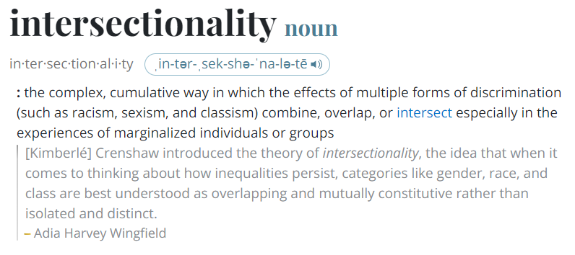
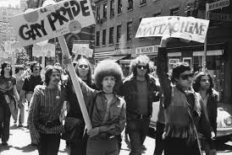
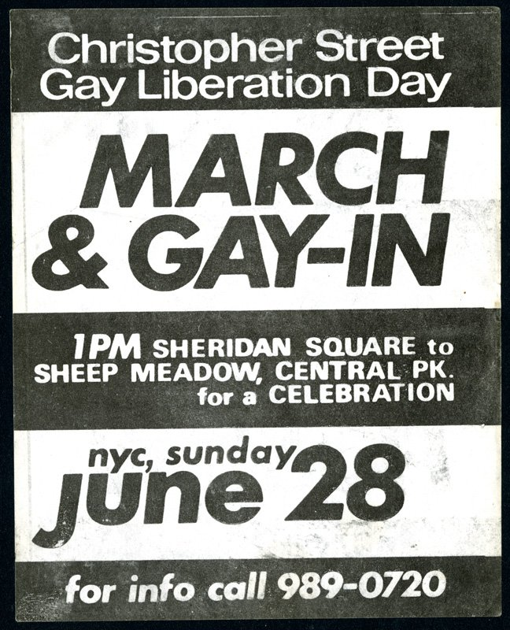
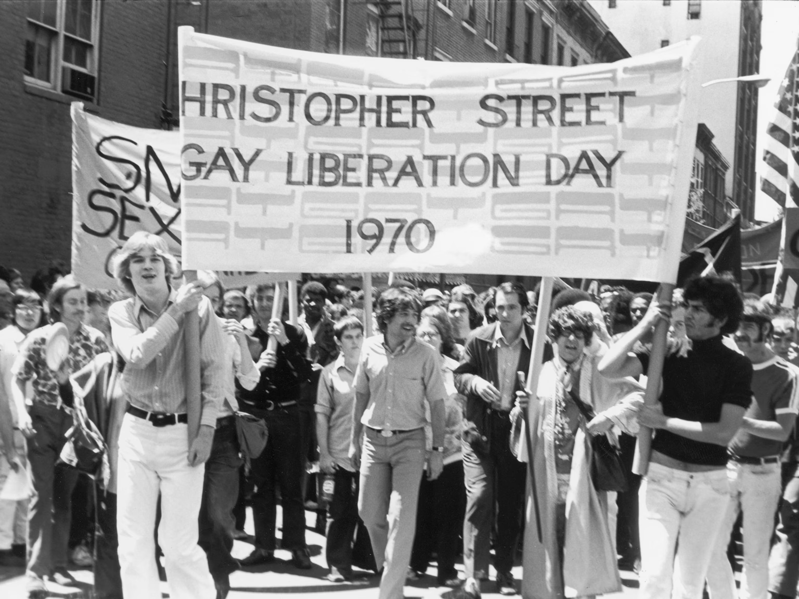
First Pride March (June 28th, 1970)
On the one-year anniversary of Stonewall, thousands of people marched in the streets of Manhattan from the Stonewall Inn to Central Park
Christopher Street Liberation Day
“Say it clear, say it loud. Gay is good, gay is proud!”
Notes:
On the one-year anniversary of Stonewall, thousands of people marched in the streets of Manhattan from the Stonewall Inn to Central Park. It was then called “Christopher Street Liberation Day,” but it went on to become America’s first gay pride parade. The parade’s official chant was: “Say it clear, say it loud. Gay is good, gay is proud.” It is important to note that the people who marched in support of LGBT rights were not just gay men and lesbian women, but trans people, people of color, allies, and people of many identities. Social justice is entirely intersectional, if you aren’t familiar with this concept, intersectionality is the cumulative way in which the effects of discrimination combine or overlap in the experiences of marginalized groups. In the words of the late, great Marsha P. Johnson, there is “No pride for some of us without liberation for all of us.”

Slide 7
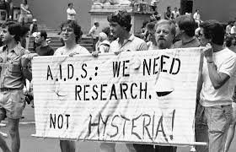
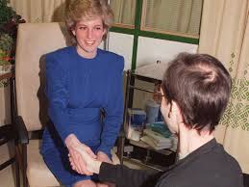
AIDS Epidemic (1981)
Acquired Immunodeficiency Syndrome (AIDS) is the most advanced stage of HIV infection
The first known cases of AIDS were reported in California in June of 1981
When cases were reported in infants and people with hemophilia, widespread panic struck and those with AIDS were stigmatized
The Reagan Administration did not publicly acknowledge the epidemic until 1985, and did not give an address on it until 1987
The crisis has had an immense global impact, claiming the lives of more than 42 million people worldwide
Notes:
In June of 1981, the CDC published a report describing requests for a drug to treat a deadly disease called Pneumocystis carinii pneumonia in five previously healthy young men in LA. This would later become known as acquired immunodeficiency syndrome, or AIDS. After the report’s publication, health officials also noticed a spike in cases of Kaposi’s sarcoma among gay men in New York. The outbreaks of both rare, deadly diseases associated with immune suppression, appearing in the same part of the population, was alarming. Upon investigation, the problem was thought to be likely due to an infectious agent that could be transmitted through sexual contact, although some speculated that recreational drugs or other environmental factors could be causes. By early 1982, health experts were concerned that transmission through heterosexual contact, transmission to newborns, or transmission through the blood supply would come next. These predictions came true and widespread panic struck America and with that, came stigmatization and rampant homophobia. People were calling it the “gay cancer.”
In 1985, a teenager with hemophilia, Ryan White, contracted AIDS from a blood transfusion. Parents in his community feared he would expose their children to AIDS, resulting in Ryan being barred from attending school before he died in 1990. The Reagan Administration did not publicly acknowledge the epidemic until 1985, following 1950s/60s actor, Rock Hudson’s death from HIV/AIDS complications. It wasn’t until 1987, when Princess Diana publicly shook hands with a gay man diagnosed with AIDS, that the general public’s perception of people with HIV/AIDS shifted. This act of kindness and compassion is considered a groundbreaking moment in the fight against the disease. The fight has continued since 1981, as the disease has claimed over 42 million lives globally, according to the World Health Organization. Today, around 40 million people worldwide are living with HIV. Breakthroughs have been made for preventative measures, and treatment for people who are HIV positive, to the point where they can be undetectable and untransmissible.

Slide 8
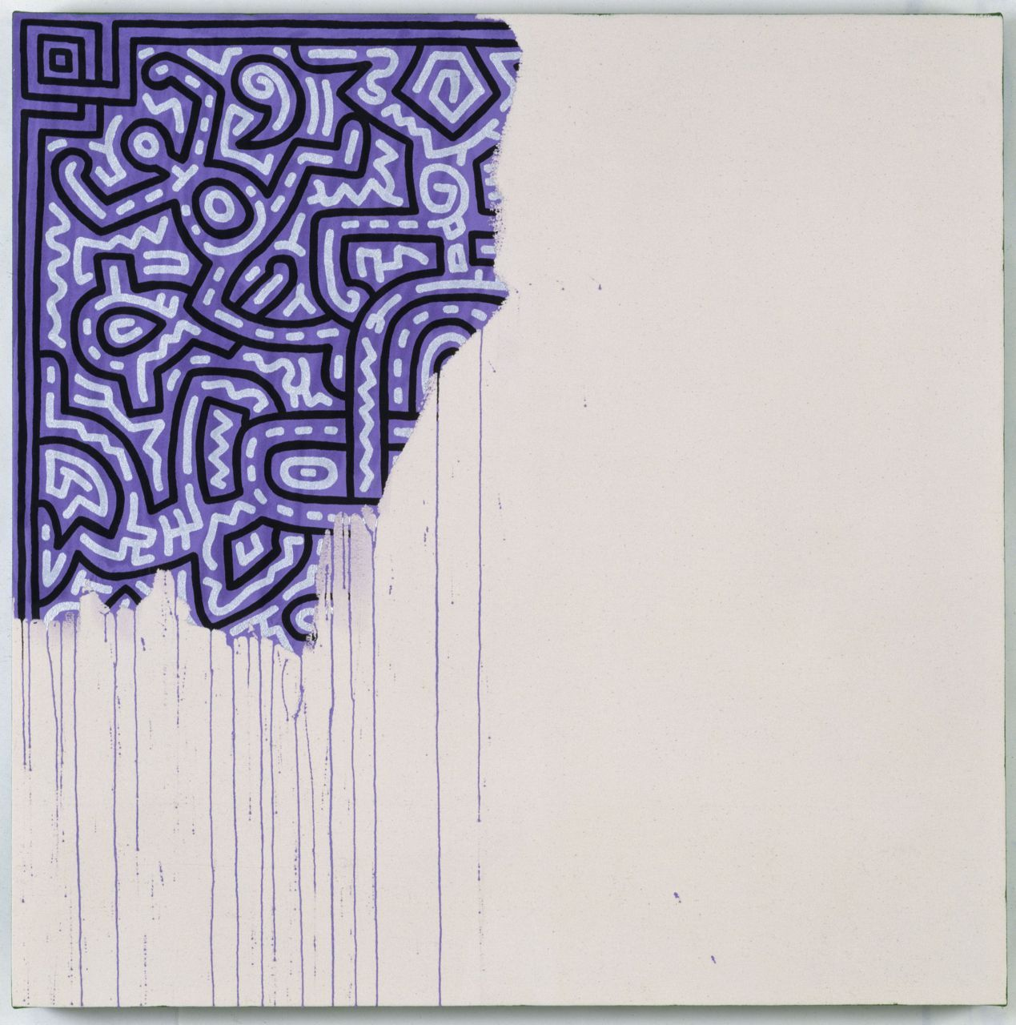
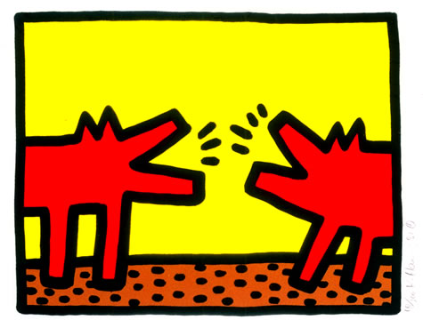
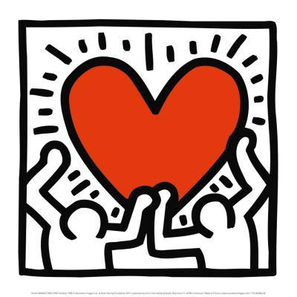
Keith Haring’s Unfinished Painting (1989)
Unfinished Painting is a 1989 painting by the American artist Keith Haring. It is known as one of Haring’s final paintings before his 1990 death from AIDS-related complications at the age of 31.
This painting has been described as a statement on the AIDS epidemic’s destruction of the gay community and culture.
Haring was notably outspoken about the AIDS epidemic in his life and artwork.
Notes:
Keith Haring is a renowned artist and gay man, who died of AIDS-related complications at the age of 31 in 1990. His artwork and style is timeless, and you would probably recognize it and see it often to this day. This particular piece I find really impactful, is titled Unfinished Painting. This was one of his last pieces of work, and it tragically and beautifully captures the loss of the gay community and culture as a result of the AIDS crisis. The LGBTQ+ community is often credited for pushing the boundaries of arts and culture, and with so many lives lost to HIV/AIDS, many great ideas were lost as well.

Slide 9
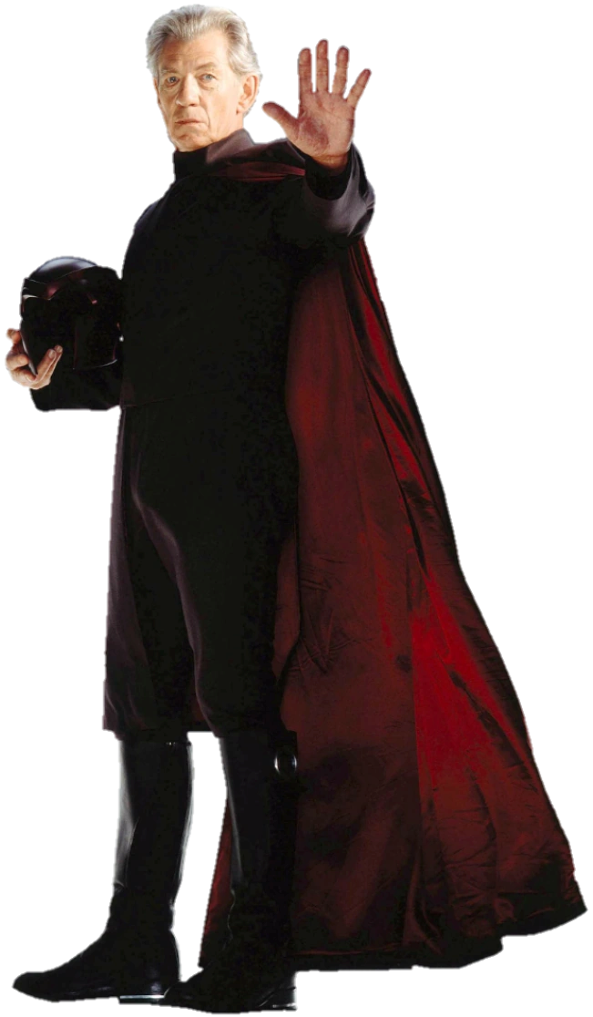
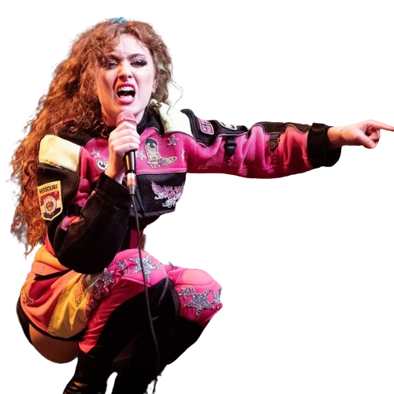
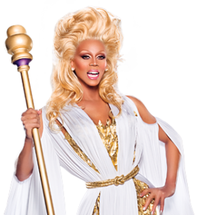
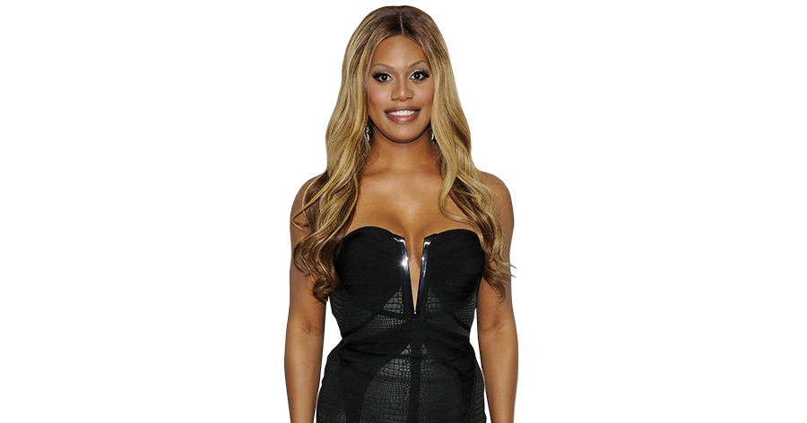
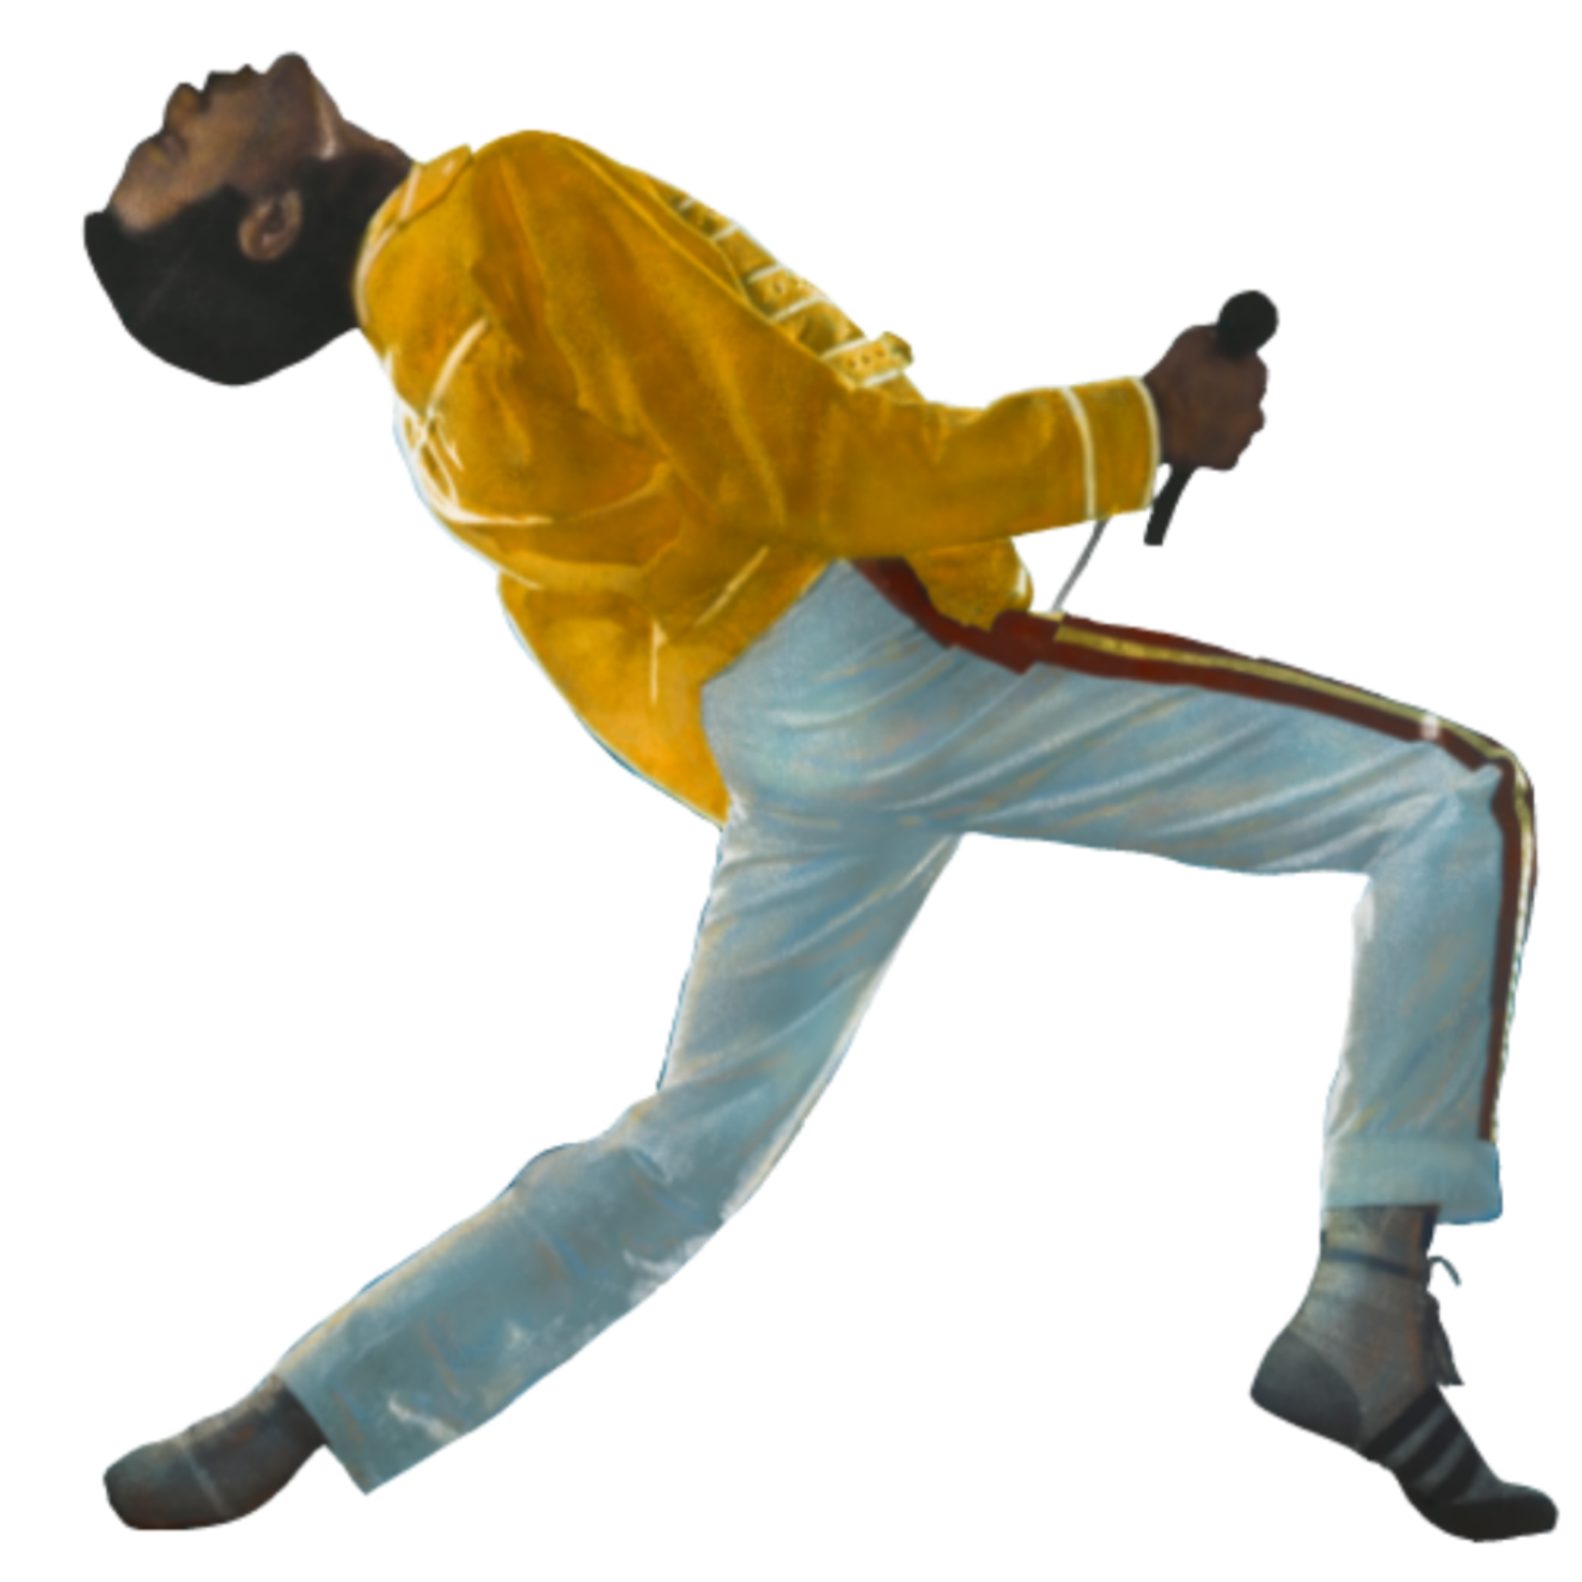
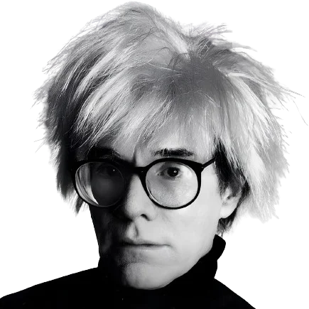
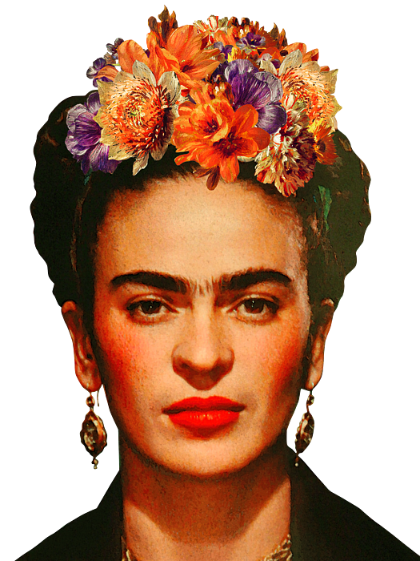
Queer Icons
Politicians/Activists
Harvey Milk
Marsha P. Johnson
Musicians
Freddie Mercury
Billie Eilish
Actors
Sir Ian McKellan
Artists/Designers
Authors
Elton John
General
RuPaul Charles
Oscar Wilde
Audre Lorde
Ocean Vuong
Michael Foucault
Elaine Noble
Sarah McBride
Chappell Roan
Troye Sivan
Big Freedia
Keith Haring
David Bowie
Laverne Cox
Sophia Bush
Bob Mackie
Chaz Bono
Rufus Wainwright
SOPHIE
Janelle Monáe
Graham Norton
Omar Apollo
Tracy Chapman
Wanda Sykes
Mae Martin
Ricky Martin
Vito Russo
Colman Domingo
Reneé Rapp
Ezra Miller
Kit Connor
Clea DuVall
Alan Cumming
Aubrey Plaza
Ben Platt
Billy Eichner
Brandon Flynn
Bowen Yang
Cara Delevingne
Cynthia Erivo
Dan Levy
Cynthia Nixon
MUNA
Jean-Michel Basquiat
Carvaggio
Jean Cocteau
Donatello
Marie Høeg
Barbara Hammer
Frida Kahlo
Michelangelo
Andy Warhol
Alice Walker
Alison Bechdel
James Baldwin
Virginia Woolf
Yukio Mishima
Kate Bornstein
Langston Hughes
Sylvia Rivera
Ellen DeGeneres
Chad Griffin
Del Martin
Phyllis Lyon
Jack Nichols
Drew Shafer
Marie Laurencin
Mickalene Thomas
Nancy Andrews
Sam Smith
Emily Dickinson
Louisa May Alcott
Sylvia Plath
Judith Butler
Nava Mau
Lady Gaga
Tom Daley
Notes:
To support this notion, I compiled a list of notable queer icons, dead and alive, who you may recognize across the media you engage with. Music legends like Freddie Mercury (AIDS) and Elton John, new popstars breaking into the scene like Chappell Roan and Billie Eilish. Olympic gold medalist Tom Daley. The first trans woman to win an Emmy award at the recent ceremony, Nava Mau. Please note that I only included people who identify or were confirmed to be queer. While you don’t necessarily need to identify as part of the community to be a queer icon, you only need to be fabulous. As much as I wanted to, I didn’t include beloved icons like Cher or Diana Ross.
Queer Icons List:
General
RuPaul Charles
Chaz Bono
Janelle Monáe
Graham Norton
Wanda Sykes
Reneé Rapp
Mae Martin
Alan Cumming
Bowen Yang
Cara Delevingne
Barbara Hammer
Ellen DeGeneres
Nancy Andrews
Tom Daley
Politicians/Activists
Harvey Milk
Marsha P. Johnson
Sylvia Rivera
Elaine Noble
Sarah McBride
Vito Russo
Michael Foucault
Chad Griffin
Del Martin
Phyllis Lyon
Jack Nichols
Drew Shafer
Musicians
Freddie Mercury
Lady Gaga
Elton John
David Bowie
Billie Eilish
Chappell Roan
Troye Sivan
Big Freedia
Rufus Wainwright
SOPHIE
Omar Apollo
Ricky Martin
Tracy Chapman
Sam Smith
MUNA
Actors
Sir Ian McKellan
Laverne Cox
Sophia Bush
Ezra Miller
Kit Connor
Aubrey Plaza
Ben Platt
Billy Eichner
Brandon Flynn
Clea DuVall
Colman Domingo
Cynthia Erivo
Dan Levy
Cynthia Nixon
Nava Mau
Artists/Designers
Keith Haring
Jean-Michel Basquiat
Carvaggio
Jean Cocteau
Donatello
Marie Høeg
Frida Kahlo
Michelangelo
Andy Warhol
Bob Mackie
Marie Laurencin
Mickalene Thomas
Authors
Oscar Wilde
Audre Lorde
Ocean Vuong
Alice Walker
Alison Bechdel
James Baldwin
Virginia Woolf
Judith Butler
Yukio Mishima
Kate Bornstein
Langston Hughes
Emily Dickinson
Louisa May Alcott
Sylvia Plath

Slide 10
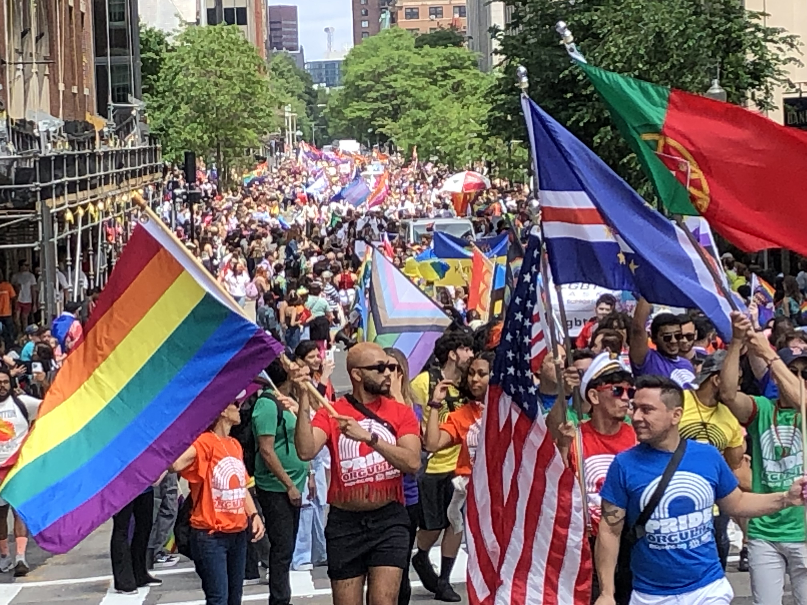
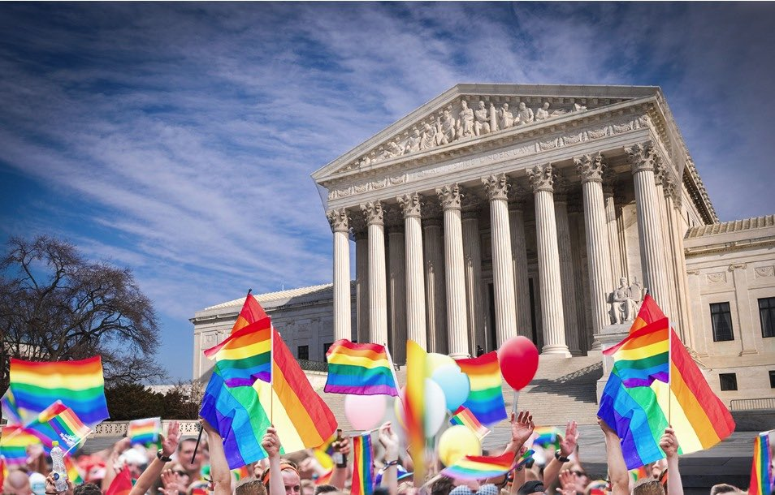
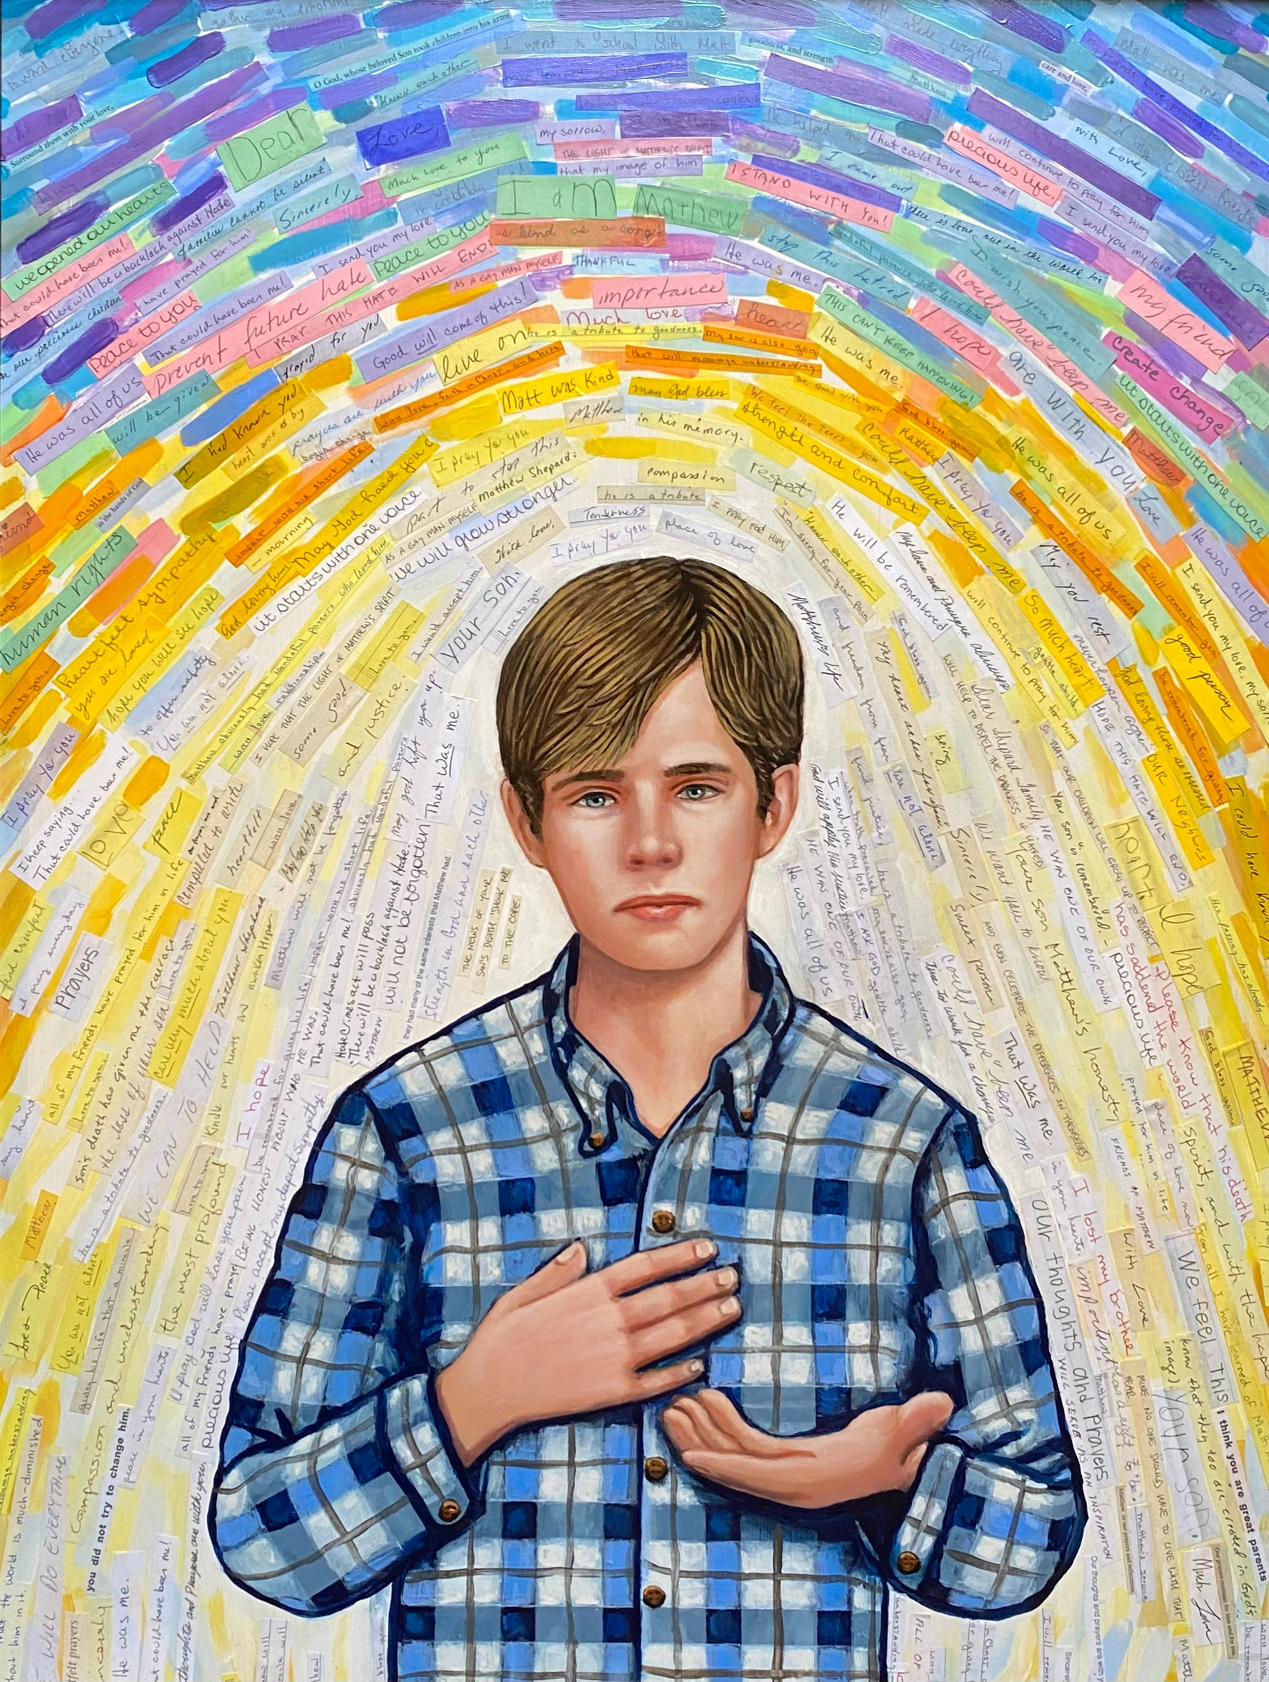
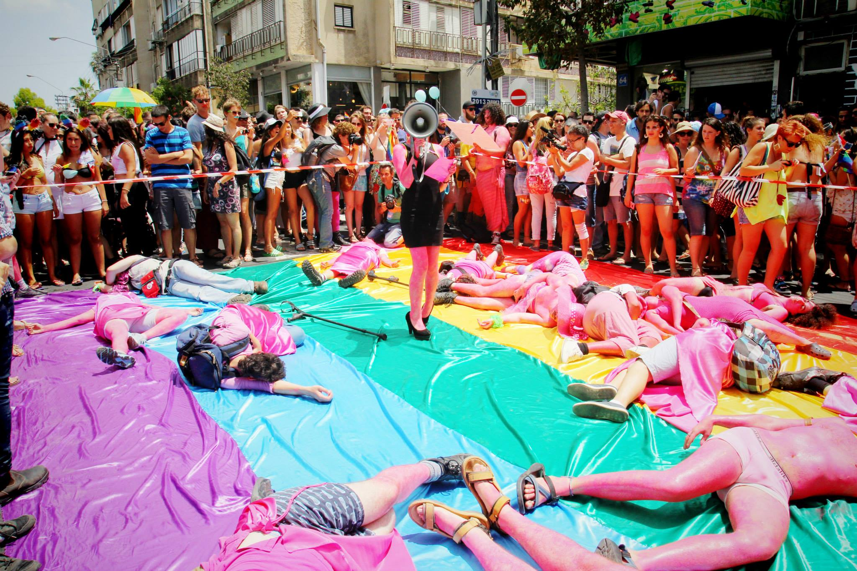
Modern Day (1998-Today)
1998 – hate crime of Matthew Shepard
June 26th, 2015 – Obergefell vs. Hodges
Pride in 2024
  Pinkwashing
Notes:
Now let’s fast forward to the year of 1998, the year that I was born. It was also the year of the infamous hate crime murder of Matthew Shepard. Matthew Shepard was a 21-year-old college student at the University of Wyoming who had just met up with friends to plan LGBT awareness week on campus. Alone at a bar afterwards, he was lured by two men around the same age as him, who were pretending to be gay and planning to rob him in their truck. They took Matthew a mile out of town, tied him to a fence, beat him with the butt of a revolver, and left him there to die. He was found 18 hours later and died 5 days later in a hospital. The news of his death breaking sparked outrage across the nation. Vigils were held and tearful politicians and celebrities gathered on the steps of the US Capitol. At the time, this was considered the most heinous anti-LGBT hate crime publicly broadcast. It was over 10 years later in 2009, when the Matthew Shepard and James Byrd Jr Hate Crimes Prevention Act was signed into law, criminalizing willful bodily injury when the crime was committed because of race, religion, nationality, sexual orientation, gender identity or disability.
After that, it was 6 more years before the Supreme Court ruled in the 2015 Obergefell v. Hodges case that states were required to license and recognize same-sex marriage. At the time I was 16 and closeted, working at an all-boys sleepaway camp in New Hampshire with limited access to our cell phones. I remember the assistant director announcing the news at breakfast the next day and the dining hall erupting with cheers of support. I remember the feeling that maybe it was okay to be gay, although it took me much longer to say those words out loud. It wasn’t until my senior year at UMass Amherst when I started coming out to my close friends, and it took me at least a year after that before I felt like I was done coming out to the people in my life. Since coming out, I feel as if I have lived my whole life in these past few years and I just wish I took the leap sooner. Now consider the fact that I am a white gay man living in Boston, Massachusetts, arguably the least marginalized of the entire global community. It took me 22 years to start living my life authentically, out of fear of being treated differently or not being accepted in spaces. I am fortunate and privileged to feel safe in my communities, but that isn’t the case for so many people across the US and the world. This is why we continue to march every June during Pride month.
Continued progress has been made over the past two decades. Pride parades occur across the country and public support for the fight for human rights is more important than ever. While Pride is bigger than ever before, it is important to note how pride has evolved over the years. Since Christopher Street Liberation Day, the Pride movement has grown massively, and with that opportunities for commercialization. Pinkwashing is a marketing practice that involves using symbolism tied to a social cause to appear in support, while simultaneously downplaying or contradicting that support in other ways. The term pinkwashing was first coined when companies promoting products with chemicals linked to breast cancer were simultaneously displaying the pink ribbon logo to appear to support breast cancer charities. Pinkwashing appears en masse every June 1st like clockwork, with countless brands updating their branding on social media with rainbows and “love is love,” without taking meaningful action to support the LGBTQ+ community. At parades, you’ll see many corporate sponsored floats with their employees walking alongside. Thank you Target and TD Bank for showing up, but this is not what Pride means to me! Instead, I find the float of elderly gays far more impactful as you watch them go by knowing they fought their whole lives to see the progress we have made today, each of them likely lost many loved ones during the AIDS crisis, or maybe that they have only been living out and proud in the later stages of life. Pride is a celebration of progress made, and a march for all the work yet to come.

Slide 11
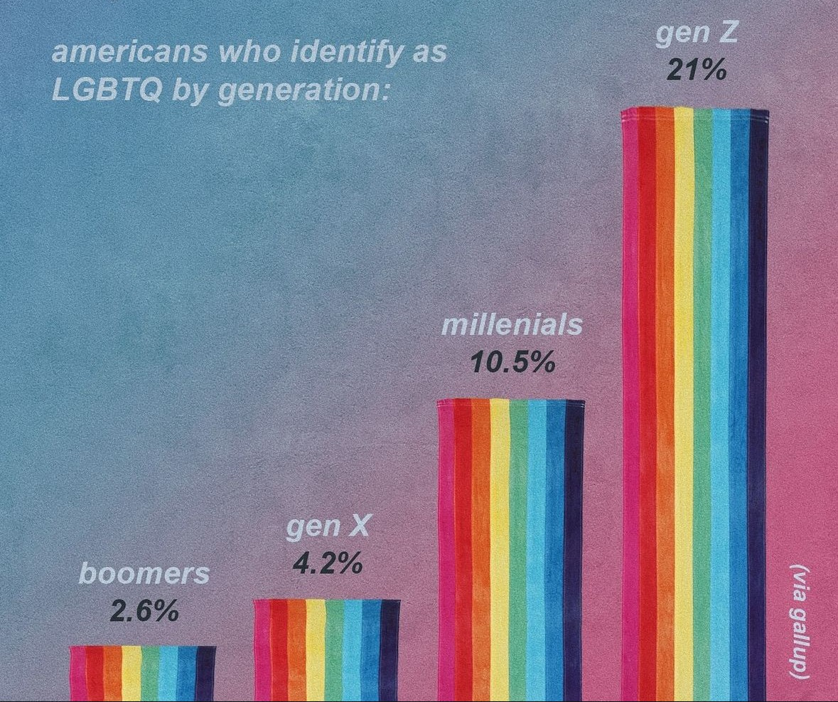
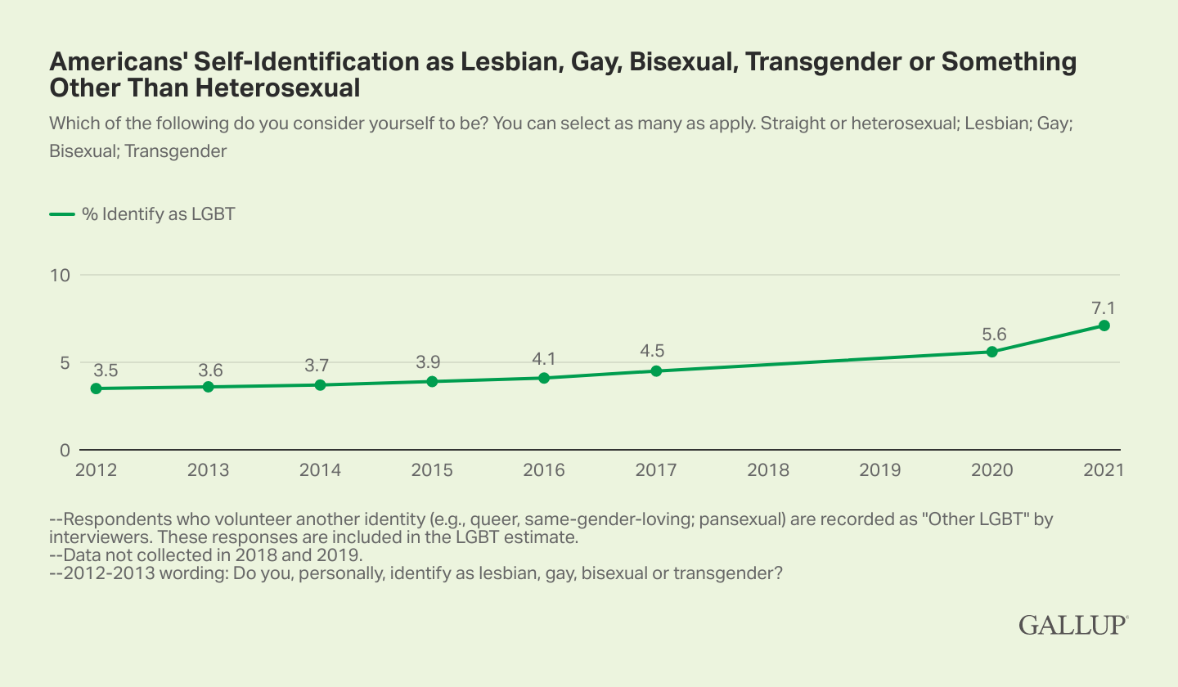
LGBTQ+ Self-Identification Stats
Notes:
Another measurement of progress made is these statistics published from Gallup, a multinational analytics company, which display growth in those who self-identify as something other than heterosexual or cisgender. You may look at this and think, “there is something in the water that’s turning the kids gay,” but what this really means is there is far better education and support for the LGBTQ+ community where people feel safer to come out and live their lives in their true identity.

Slide 12
Timeline of LGBTQ+ Rights
1620
1945
1620 – Colonial life in Plymouth and the establishment of Puritan norms
1778 – Lieutenant Gotthold Frederick Enslin of the Continental Army becomes the first documented service member to be dismissed from the U.S. military for homosexuality
1862 – Jennie Hodgers, disguised as a man named Albert Cashier, enlisted in the Union army in Illinois and fought for three years until the end of the war. She was one of 400 documented cases of women who dressed as men to support the war effort and continued living as a man after the war
1868 – Two-Spirit, We’wha, a Zuni Native American, meets with President Grover Cleveland
1890 – The term, Lesbian, first used in a medical dictionary
1895 – Trial of Oscar Wilde (writer and novelist) in London, England and convicted for gross indecency (relationships with other men) and served two years in jail
1917-1935 – The Harlem Renaissance. Historians have stated that the renaissance was “as gay as it was black.” Some of the lesbian, gay or bisexual people of this movement included writers and poets such as Langston Hughes, Countee Cullen and Zora Neale Hurston; Professor Alain Locke; music critic and photographer Carl Van Vechten, and entertainers Ma Rainey, Bessie Smith, Ethel Waters and Gladys Bentley
1924 – The Society for Human Rights, the first gay rights organization, was founded by Henry Gerber in Chicago who had emigrated from Germany. The organization ceased to exist after most of its members were arrested
1933 – 1945 – Nearly 100,000 German homosexual men were rounded up and placed in concentration camps along with Jewish people. They were designated by a pink triangle on their clothing

Slide 13
Timeline of LGBTQ+ Rights (1952-1970)
1952
1970
1952 – Christine Jorgensen became one of the most famous transgender people when she underwent a sex change operation and went on to a successful career in show business
1952 – The American Psychiatric Association’s diagnostic manual lists homosexuality as a sociopathic personality disturbance that could be treated
1955 – Daughters of Bilitis, the first lesbian rights organization is founded in San Francisco, California by Phyllis Lyon and Del Martin. They hosted private social functions, fearing police raids, threats of violence and discrimination in bars and clubs. The organization lasted until 1969
1962 – Illinois becomes the first state to decriminalize homosexual acts between two consenting adults in private
1969 (June 28) – The Stonewall Uprising in New York City
1969 – Gay Liberation Front organization formed in New York following the Stonewall Riots to advocate for sexual liberation for all people.
1969 – The Gay Activist Alliance formed in New York by a group who were not satisfied with the direction of the Gay Liberation Front. Their purpose was more political, and they wanted to “secure basic human rights, dignity and freedom for all gay people.”
1970 – The first gay pride marches were held in multiple cities across the United States on the first anniversary of the Stonewall Riots, including San Francisco and Los Angeles/West Hollywood

Slide 14
Timeline of LGBTQ+ Rights (1973-1979)
1973
1979
1973 – The American Psychiatric Association, after considerable advocacy by Frank Kameny and members of the Mattachine Society, changed the classification of homosexuality as a mental disorder. It was not until 1987 that homosexuality was completely removed from the APA list of mental disorders.
1974 – Elaine Noble becomes the first openly gay person to be elected as a state legislator; she served in the Massachusetts State House of Representatives for two terms.
1977 – Harvey Milk elected county supervisor in San Francisco and becomes the third “out” elected public official in the United States. Quebec, Canada passed laws to prohibit discrimination based on sexual orientation in both the private and public sectors.
1978 – The Briggs Initiative, a statewide proposition in California, was defeated by 58% of the voters. The initiative would have banned gays and lesbians from working in California’s public schools.
1978 (June 25) – In San Francisco, the Rainbow Flag is first flown during the Gay Freedom Parade; the flag becomes a symbol of gay and lesbian pride.
1978 (Nov. 27) – San Francisco Supervisor Harvey Milk is assassinated along with Mayor George Moscone.
1979 – National March on Washington for Lesbian and Gay Rights. Over 100,000 people gathered in support of gay and lesbian rights.

Slide 15
Timeline of LGBTQ+ Rights (1981-2024)
1981
2024
1981 – AIDS Epidemic begins. The U.S. Center for Disease Control reported the first cases of a rare lung disease, which would be named AIDS (Acquired Immune Deficiency Syndrome) the following year
1985 – Rock Hudson dies
1987 – Princess Diana of Wales shakes hands with AIDS patient in London hospital
1993 – The U.S. Congress passed and President Bill Clinton signed “Don’t Ask Don’t Tell” that allowed gay and lesbian people to serve in the military. They would not be asked their sexual orientation during enlistment screening
1998 – Matthew Shepard, a 21-year-old student at the University of Wyoming, was brutally attacked and tied to a fence in a field outside of Laramie, Wyo. and left to die because he was gay.
2003 – Lawrence v. Texas: Ruled by a vote of 6-3 that a Kansas law criminalizing gay or lesbian sex was unconstitutional declaring the importance of constitutional liberty and privacy consistent
2010 – The U.S. Congress passed and President Barack Obama signed the repeal of “Don’t Ask Don’t Tell” so that gay and lesbian people could serve openly in the military.
2015 – Obergefell v. Hodges: The Court voted 5-4 that the fundamental right to marry is guaranteed to same-sex couples by both the Due Process Clause and the Equal Protection Clause of the Fourteenth Amendment of the U.S. Constitution. This decision mandated that states must allow same-sex couples to legally marry
2016 – Pulse nightclub shooting in Orlando, Florida, killing 49 people and wounding 53 more
2023 – Tennessee drag ban was signed into law

Slide 16
Queer Theory: Revisited
Queer theory ultimately raises the question of whether the notion of fixed sexual identities is desirable or even tenable
Demonstration of the instability of binary oppositions (Male/Female, hetero/homosexuality, etc.):
  Masculinity can be demonstrated to be an unstable cluster of fears about effeminacy
    Leads to repressed homosexual or homosocial desires, rather than simply the opposite of femininity
We are all products of social and historical construction
“Deconstruction is not destruction” – Jacques Derrida
Notes:
Queer theory aims to dissect the binary, and ultimately raises the question of whether the notion of fixed sexual identities is desirable or even tenable. This connects back to the reclamation of the word “queer” as a preferred self-identifier for those who do not wish to be put in a box. A similar example to this is the preference of some to use they/them pronouns, as they do not feel represented within the binary of he or she. For queer theorists, sexuality is a complex array of social codes and forces which form individual activity and institutional power, which then interact to shape the ideas of what is normative and what is deviant. This creates a rubric for what is “natural.”
While this presentation highlighted many of the challenges and tragedies projected onto the LGBTQ+ community by society, queer history is far more nuanced than a series of unfortunate events and societal treatment. Against all odds, queer people have always found a way to navigate, survive, and thrive in the face of oppression. From the underground bar scenes of the 50s and 60s, to the millions of people who march in Pride parades each year today, queer people have always existed and will continue to exist and thrive in a society which was not built for them.

Slide 17
Recommended Homework
To Watch
To Read
The Birdcage (1996)
Will & Harper (2024)
Paris is Burning (1990)
But I’m a Cheerleader (1999)
Milk (2008)
Moonlight (2016)
Portrait of a Lady on Fire (2019)
Rent (2005)
To Wong Foo, Thanks for Everything! Julie Newmar (1995)
National Anthem (2023)
I Saw the TV Glow (2024)
The Death and Life of Marsha P. Johnson (2017)
The Boys in the Band (1970)
Gay American History: Lesbians and Gay Men in the USA – Jonathan Ned Katz (1972)
Giovanni’s Room – James Baldwin (1956)
The Song of Achilles – Madeline Miller (2011)
The Color Purple – Alice Walker (1982)
Left Hand of Darkness – Ursula K Le Guin (1969)
The Price of Salt – Patricia Highsmith (1952) (republished in 1990 under the title Carol)
The Velvet Rage – Alan Downs (2005)
The Picture of Dorian Gray – Oscar Wilde (1891)
Notes:
I hope you all learned something from this presentation and if you are eager to engage with the subject matter further, please check out this list of movies to watch and books to read. There are comedies on there, historical non-fictions, dramas, and more. If you end up watching some of these, pay attention to the way queerness is represented at different times that these came out.

Slide 18
Q & A

Slide 19
Upcoming UMPO DEIA Events
Event | Date | Details | Employee Leads
Sheryl Faye Presents Historical Women: Anne Frank | October 30 12pm-1pm 50 Washington St | Living history presentation by a local actress who portrays women in history | Sam Burling (Internal Audit) and Pam Giordano (UPST)
Diwali Luncheon in Westboro | November 6 12pm-2pm 50 Washington St | Similar Diwali celebration event as last year with increased size | Kristina England (UITS), Akshit Mehta (UPST), and Maria Dahood (UITS)
Veterans Day – Tell Your/Their Story | November 14 12pm-1pm Remote | UMPO employees will be invited to tell their story if they are a veteran or to tell the story of a family member who is/was a veteran or in active service | John Dunlap (HR) and Sam Burling (Internal Audit)
Story Hour with Chanda Wolf | October 19 at 10am (Lowell) and November 3 at 10:30am (Brookline) | Chanda Wolf reads A Dozen Delicious Donuts which captures the journey of the immigrant experience | Chanda Wolf

Slide 20
Appendix

Slide 21
Resources
https://www.masterclass.com/articles/queer-theory
https://guides.loc.gov/lgbtq-studies/stonewall-era
https://www.history.com/topics/gay-rights/the-stonewall-riots
https://catalog.loc.gov/vwebv/search?searchCode=LCCN&searchArg=2018411915&searchType=1&permalink=y
https://lgbtqhistory.org/lgbt-rights-timeline-in-american-history/
https://lgbthistorymonth.com/background
https://www.cdc.gov/museum/online/story-of-cdc/aids/index.html
https://www.hiv.gov/hiv-basics/overview/data-and-trends/statistics
https://www.youtube.com/watch?v=74k8OvL-NiQ
https://www.justice.gov/crt/matthew-shepard-and-james-byrd-jr-hate-crimes-prevention-act-2009-0

