Slide 1
UMass Disability Pride Program
The disability pride flag with a black background and downward diagonal strips of red, yellow, white, light blue, and green
July 26, 2022
Elizabeth (liz) Anh Thomson, PhD (University of Minnesota Morris)
Jeff Edelstein, PhD Student (UMass Amherst)
Notes:
Found the Vector image for the Disability Pride Flag through Wikipedia: https://commons.wikimedia.org/wiki/File:Visually_Safe_Disability_Pride_Flag.svg

Slide 2
Accessibility
Read all text aloud
Describe all images
Use plain language and visuals
Slides are numbered
High contrast colors
Be mindful of our rate of speaking
Live captioner
ASL interpreters
Slides are caption friendly
Slide deck double checked for access
Notes:
Liz copy/paste items

Slide 3
Grounding Assumptions
We can hold multiple things at once. Being pleased and proud of accomplishments, disability pride, and still challenge ableism at the university.
Disabled people/people with disabilities contribute and have contributed to the academy in meaningful ways.
Disability is part of diversity, equity, and inclusion (DEI) work.
Those in attendance today come from a wide variety of positions of power and privilege around the university
Notes:
Establish what assumptions we’re bringing into this space about the topic and the audience/space

Slide 4
Session Overview
Introductions
Grounding Assumptions
Central Terms and Concepts
Person First and Identity First Language
Ableism, Academic Ableism, and Internalized Ableism
Brief Overview of Models of Disability
Panel Discussion
Questions
Recommended Resources
Notes:
Verbal mention of time/length of presentation, estimated timepoints for sections
Benchmarks
10:15 CT/11:15 ET = Arrive at Panel Discussion
10:45 CT/11:45 ET = Arrive at Q & A

Slide 5
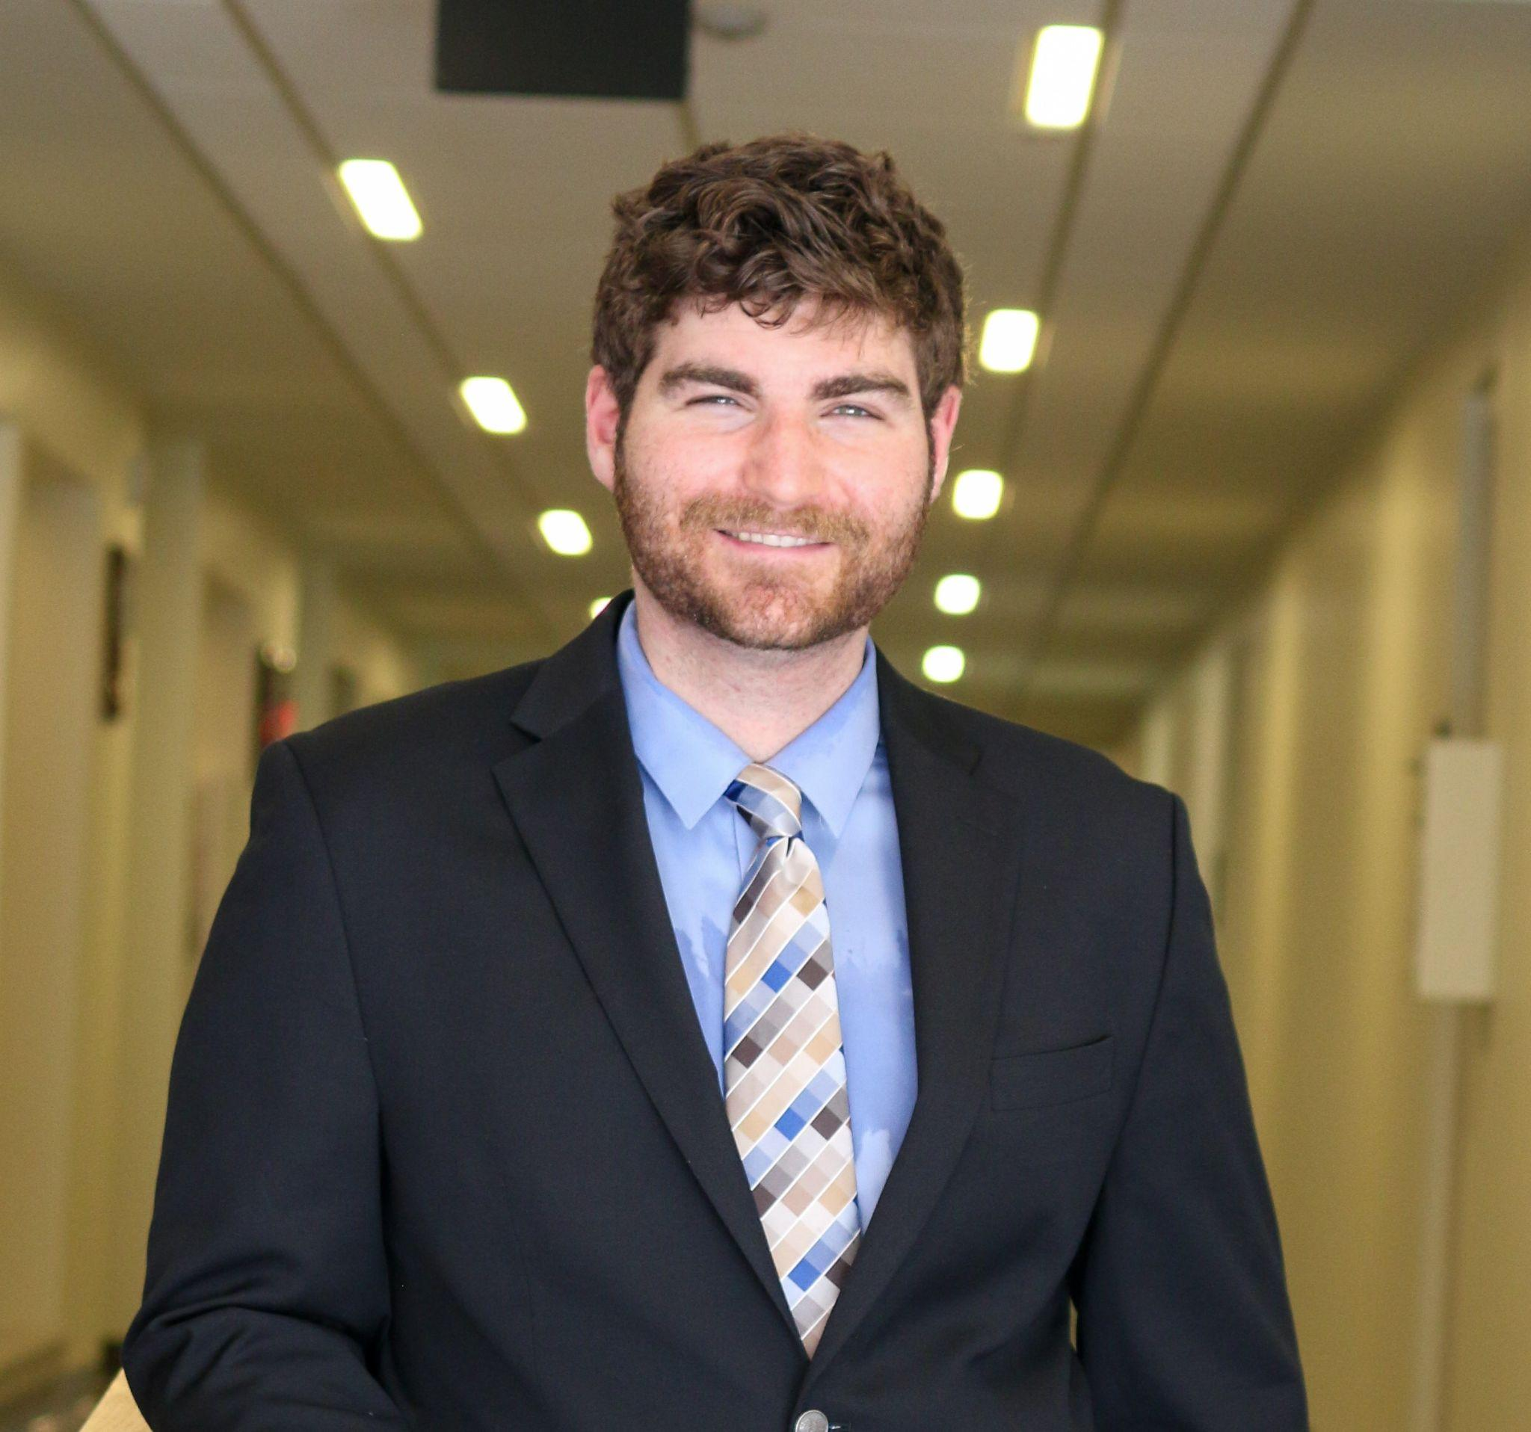
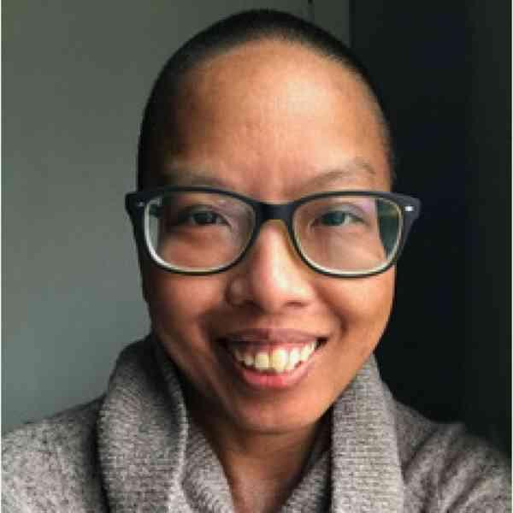
Introductions
Jeff Edelstein (he/they)
Elizabeth (liz) Anh Thomson (they/them)
Indoors, a white, bearded, masculine-presenting person with short, brown curly hair is shown smiling. They are wearing a black suit jacket, blue dress shirt, and tie with a gold, blue, and black patterning
Indoors, close up headshot of a a dark-skinned Vietnamese gender non-conforming person smiling with shaved black hair, charcoal rimmed glasses, and black eyes. They are wearing a beige sweater with a loose collar.
Notes:
Similarity to speaker descriptions on the event website; additions/differences for the day of
Note each of our relationships relative to UMass

Slide 6
Central Terms and Concepts

Slide 7
Person-First and Identity-First Language
Language is a social construct, comes with histories, and is always changing.
Person-first language example:
He is a person with a disability.
Identity-first language example:
He is a disabled person.
Some people have a strong opinion on which to use for themselves. Some alternate between the two. A recommendation is to use the language the person is using.
Notes:
Liz will develop more text

Slide 8
Ableism, Academic Ableism, and Internalized Ableism
Ableism - the discrimination of and social prejudice against people with disabilities based on the belief that typical abilities are superior (accessliving.org)
Academic Ableism - the systemic and individual way ableism shows up in the academy (Dolmage, 2017)
Internalized Ableism - how a disabled person absorbs ableism; can have negative thoughts about disability; limits themselves
Notes:
Potential addition of something speaking to the reinforcement of ableism in society?
Disableism(?)
Grounding example for each, maybe?
Ableism =
Academic Ableism =
Internalized Ableism = Hesitancy to use accommodations(?)

Slide 9
Brief Overview of Selected Disability Models
Green graphic of a medical clipboard with a circle with a cross inside it
Green graphic of a wheelchair user going up a ramp
Green graphic of two large nondescript people on the left of a plank; two smaller nondescript people standing on two blocks on the right of the plank; the plank is balanced with an equal sign enclosed by dotted lines above it
Medical Model
Social Model
Social Justice Model

Slide 10
Panel Discussion

Slide 11
Q & A

Slide 12
Recommended Resources–Open Access Books & Articles
Open Access Books
Academic Ableism by Jay T. Dolmage
Ableism in Academia by Nicole Brown & Jennifer Leigh
Articles (May Require Institutional Log-in)
Make It Safe For Employees to Disclose Their Disabilities, Harvard Business Review
How Disabled and Neurodivergent Faculty Live, Inside Higher Ed
Colleges Should Make it OK for Faculty to Disclose Disabilities, Inside Higher Ed
Stop Telling Us ‘You Hide it So Well,’ Inside Higher Ed
In Fight Against Ableism, Students Create Centers of Their Own, The Chronicle of Higher Education
The Neglected Demographic: Faculty Members with Disabilities, The Chronicle of Higher Education
Notes:
Evans, N. J., Broido, E. M., Brown, K. R., & Wilke, A. K. (2017). Disability in Higher Education: A Social Justice Approach. San Francisco, CA: Jossey-Bass.
Heumann, J. (2020). Being Heumann: An Unrepentant Memoir of a Disability Rights Activist. Boston, MA: Beacon Press.
Kerschbaum, S. L., Eisenman, L. T., & Jones, J. M. (Eds.). (2017). Negotiating Disability; Disclosure and Higher Education. Ann Arbor: University of Michigan Press
Kim, E., & Aquino, K. C. (Eds.). (2017). Disability as Diversity in Higher Education: Policies and Practices to Enhance Student Success. New York, NY: Routledge
Kleege, G. (2018). More than meets the eye; what blindness brings to art. Oxford: University Press.
Sins Invalid (2020). Skin, Tooth, and Bone (2nd Edition).
Wong, A. (Ed.). Disability Visibility: First-person Stories from the Twenty-First Century. New York: Vintage Books.

Slide 13
Recommended Resources–Organizations & Blogs
Organizations
Autistic Self-Advocacy Network
Autism Women and Non-Binary Network
Sins Invalid
Rooted in Rights
ADA National Network
Massachusetts Office on Disability
Alliance Against Ableism
UMass Allies for Illness and Disability Access (UMAIDA)
Blogs
Autistic Hoya by Lydia X.Z. Brown
Leaving Evidence by Mia Mingus
Planet of the Blind by Steve Kuusisto
Brown Star Girl by Leah Lakshmi Piepzna-Samarasinha
.

Slide 14
Recommended Resources–Podcasts & Videos
Podcasts
Disability After Dark (NSFW) by Andrew Gurza
Disability Visibility by Alice Wong
Reid My Mind by Thomas Reid
The Accessible Stall by Kyle Khachadurian and Emily Ladau
Videos
Crip Camp: A Disability Revolution (Documentary; Available on YouTube)
Notes:
Lebrecht, J. & Newnham, N. (Directors). (2020). Crip Camp: A Disability Revolution [film]. Netflix.

Slide 15
Contact Information
Thank you!
Elizabeth (liz) Anh Thomson, PhD (University of Minnesota Morris)
Email: lthomson@morris.umn.edu
Jeff Edelstein, PhD Student (UMass Amherst)
Email: jedelstein@umass.edu; jeffrey.edelstein@umb.edu
Twitter: @Jeff_Ed_

