Slide 1
Title Slide
Subtitle

Slide 2
Agenda Sample

Slide 4
Sample Headline (Size 28)

Slide 5
Sample Headline (Size 28)
Sample Subhead (Size 20)
Sample Subtitle (Size 20)
Sample Subtitle (Size 20)

Slide 6
PowerPoint Brand Assets
Embedded Fonts
Embedded Color Palette
Headline: Montserrat
Subhead: Montserrat
Subtitle: Open Sans
Body: Open Sans
Charts and Graphs: Open Sans
Quotations: Lora

Slide 7
Sample Bar Chart

Slide 8
Sample Pie Chart

Slide 9
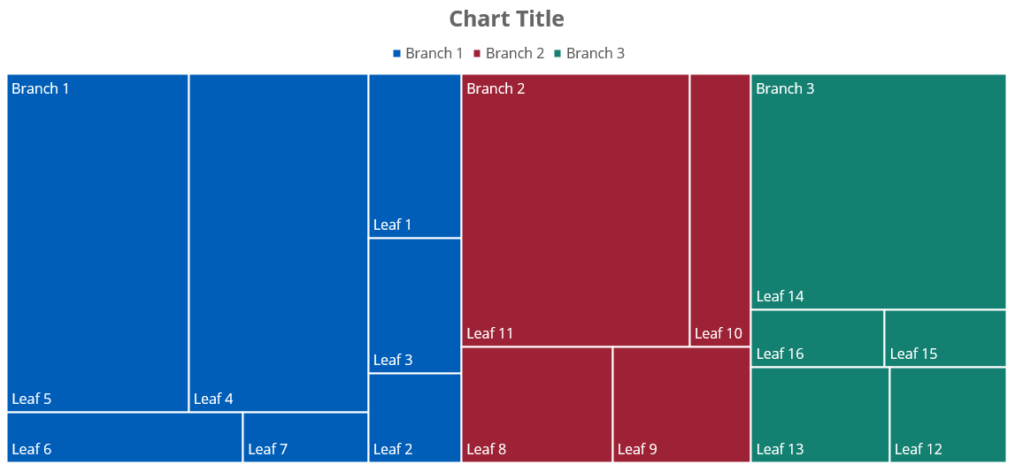
Sample Treemap

Slide 10
Sample Table and SmartArt

Slide 11








Iconography
Microsoft PowerPoint offers a robust selection of standardized icons for all uses. To add icons to your presentation, go to Insert > Icons, and select your preferred icons.
The template standardizes icons in black, but if changing, be sure to use the brand colors from the PowerPoint color palette (Ideally, a darker color like blue, green or maroon).

